Slide 1
Generic Collections: Functional Programming with LINQ/PLINQ
Chapter 21 of Visual C# How to Program, 6/e

Slide 2
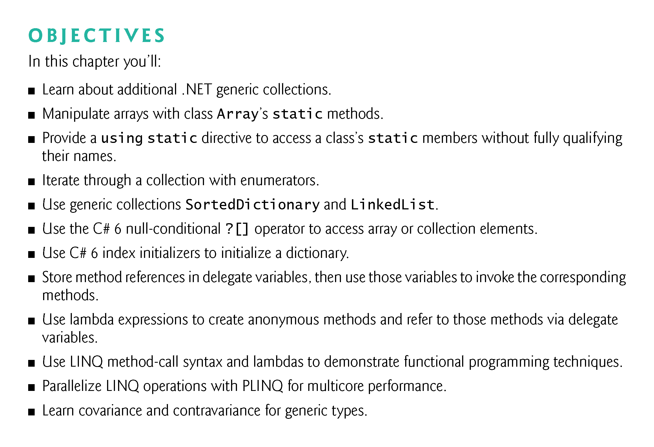

Slide 3
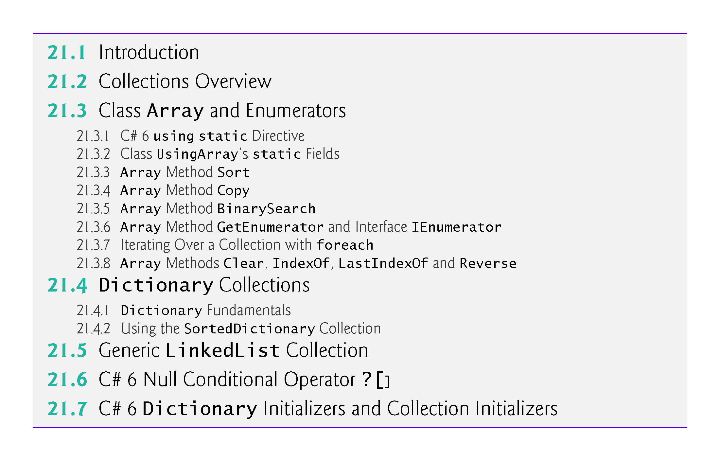

Slide 4
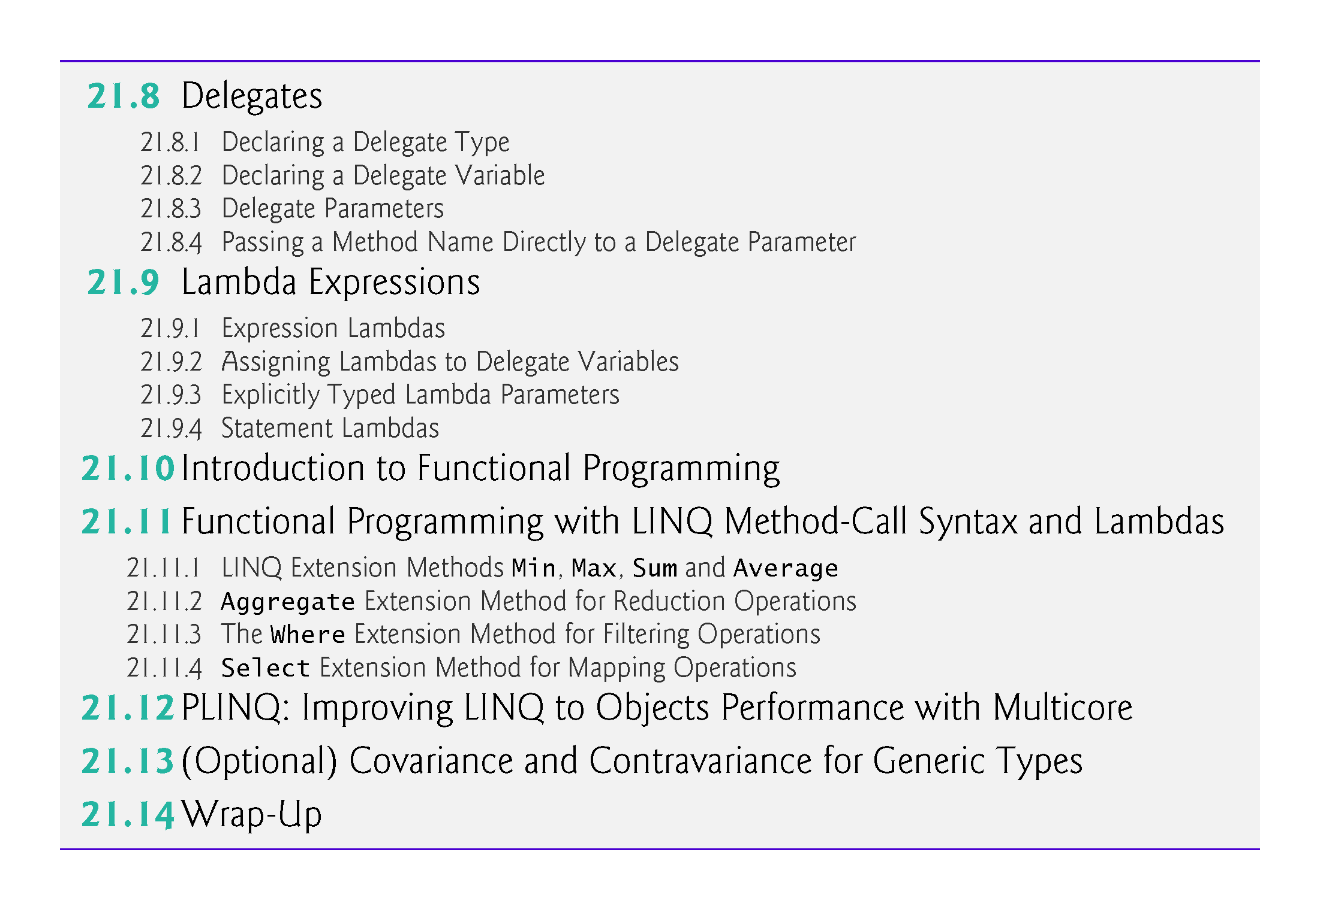

Slide 5
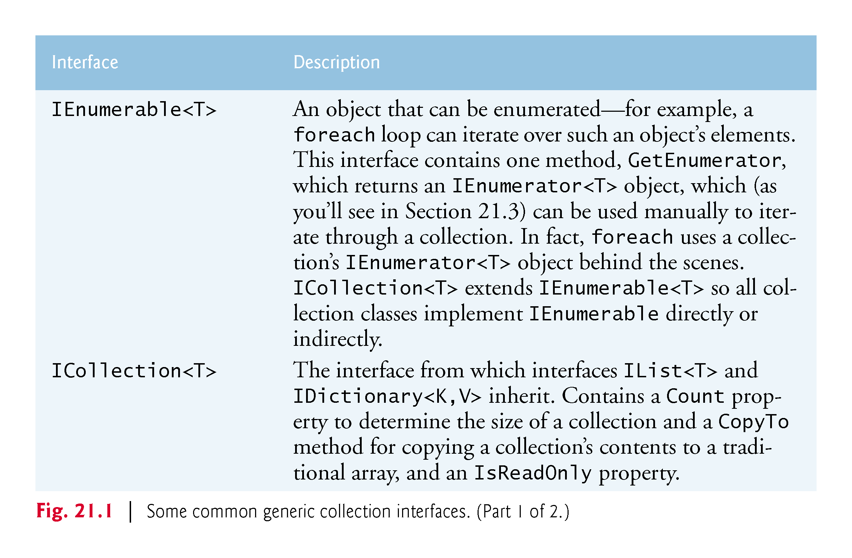

Slide 6
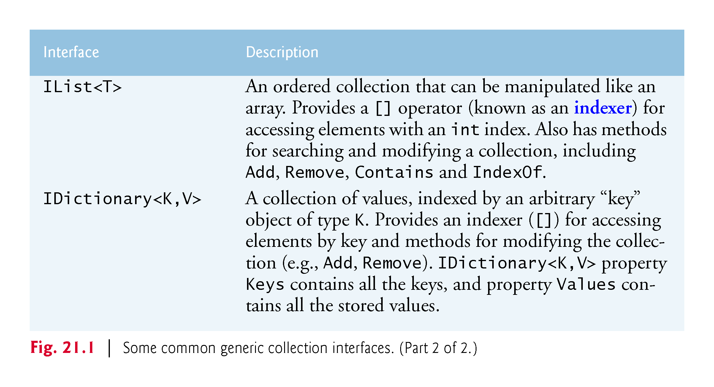

Slide 7
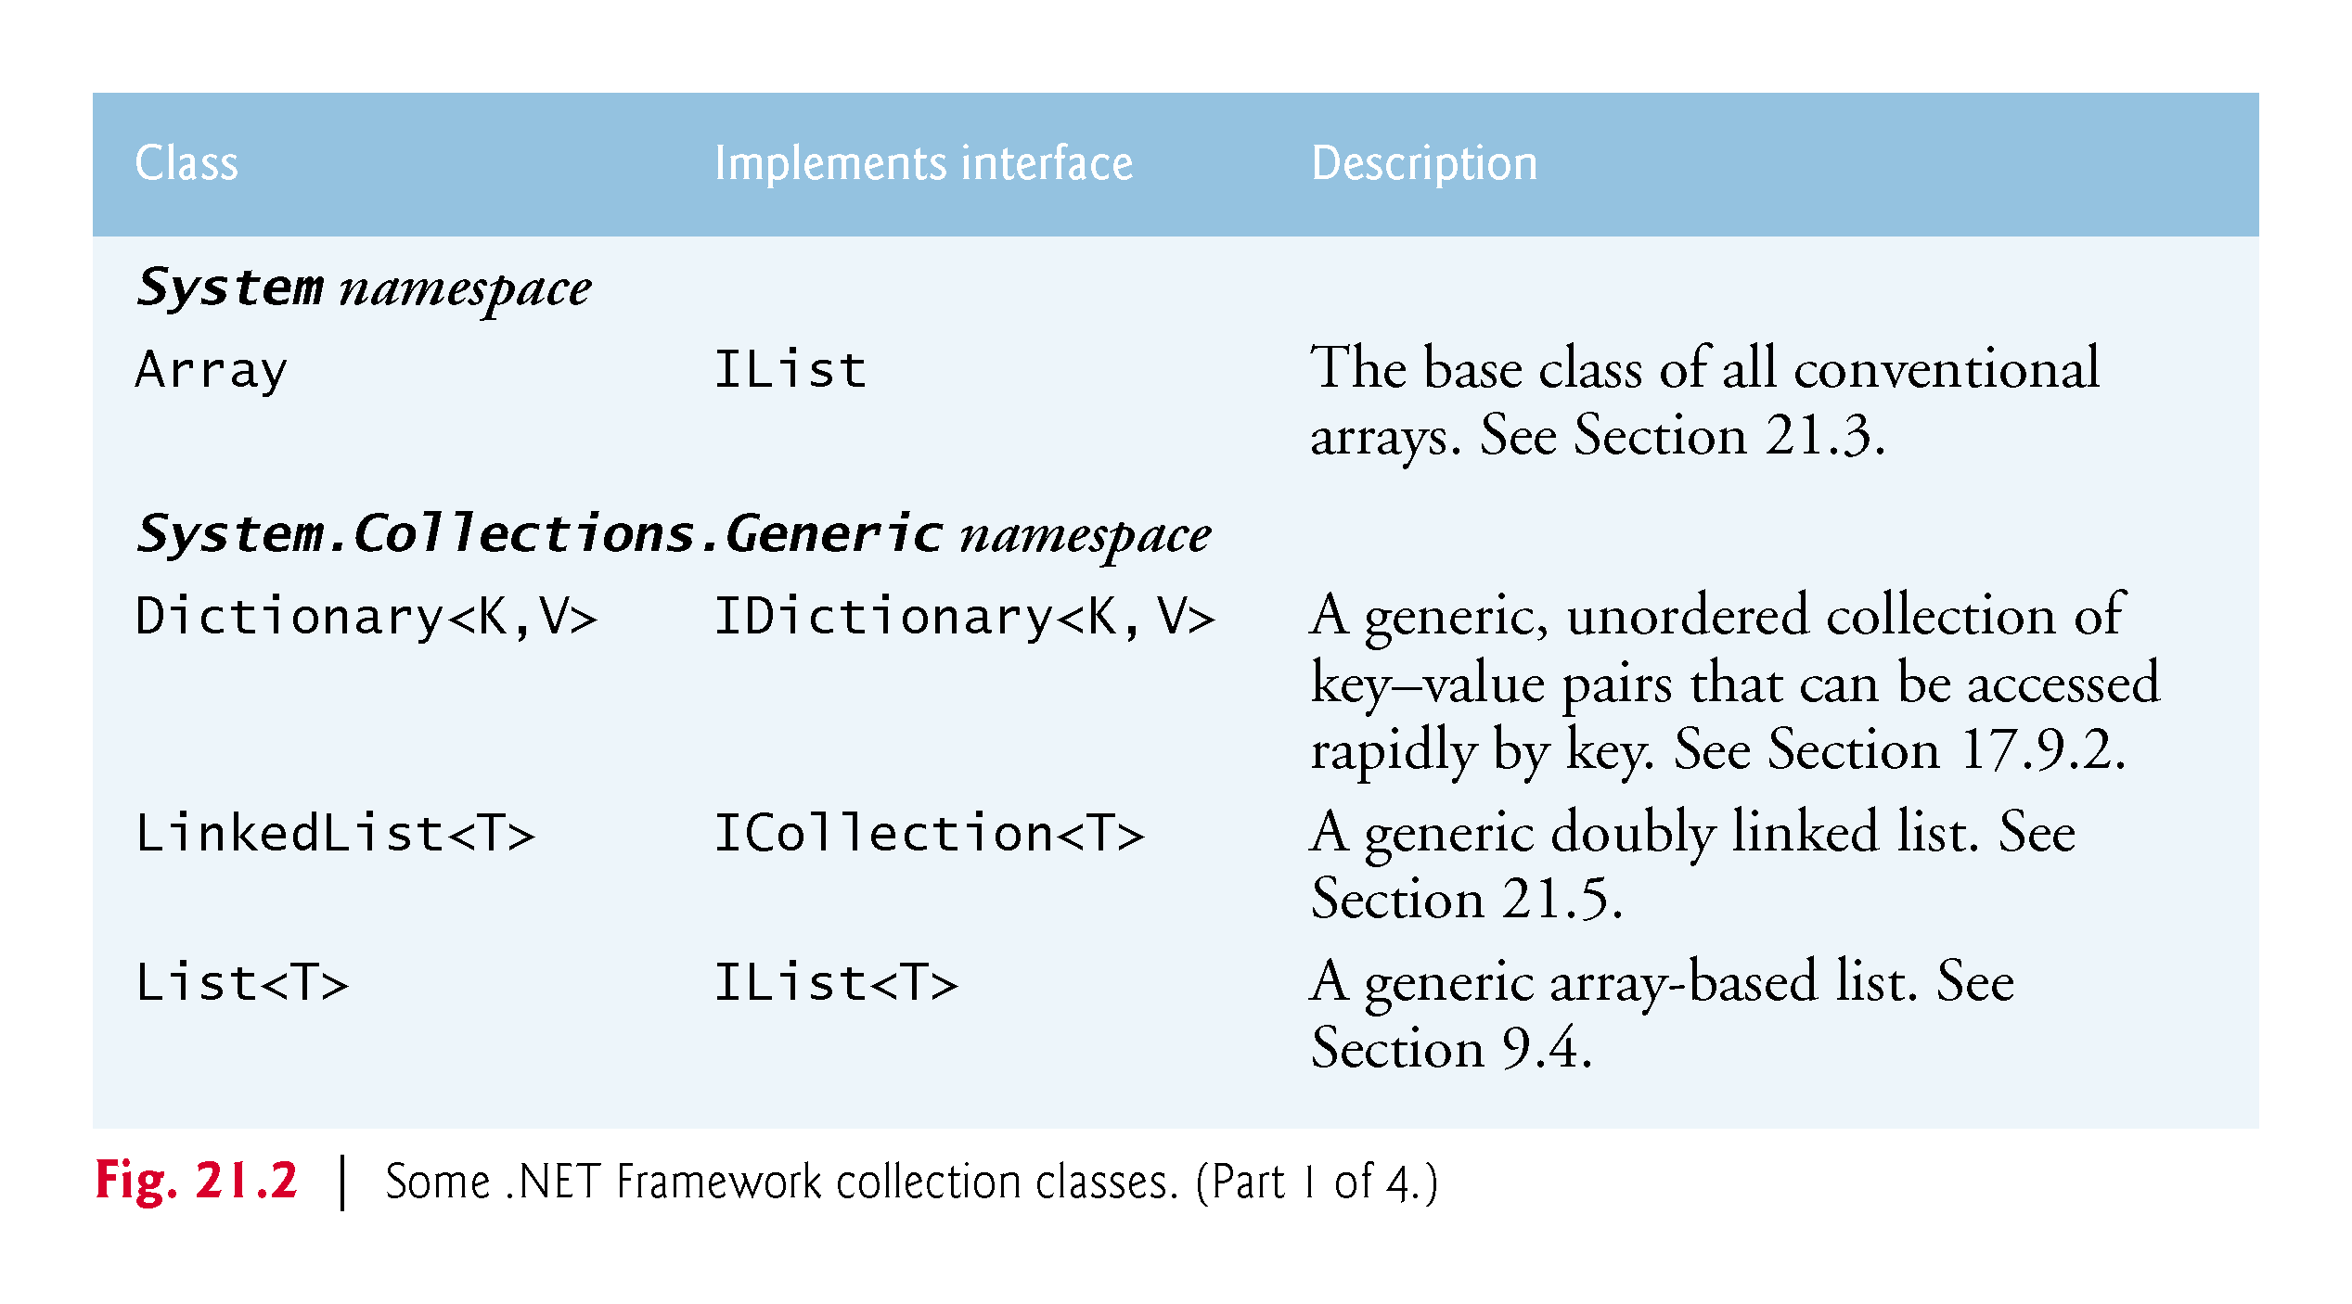

Slide 8
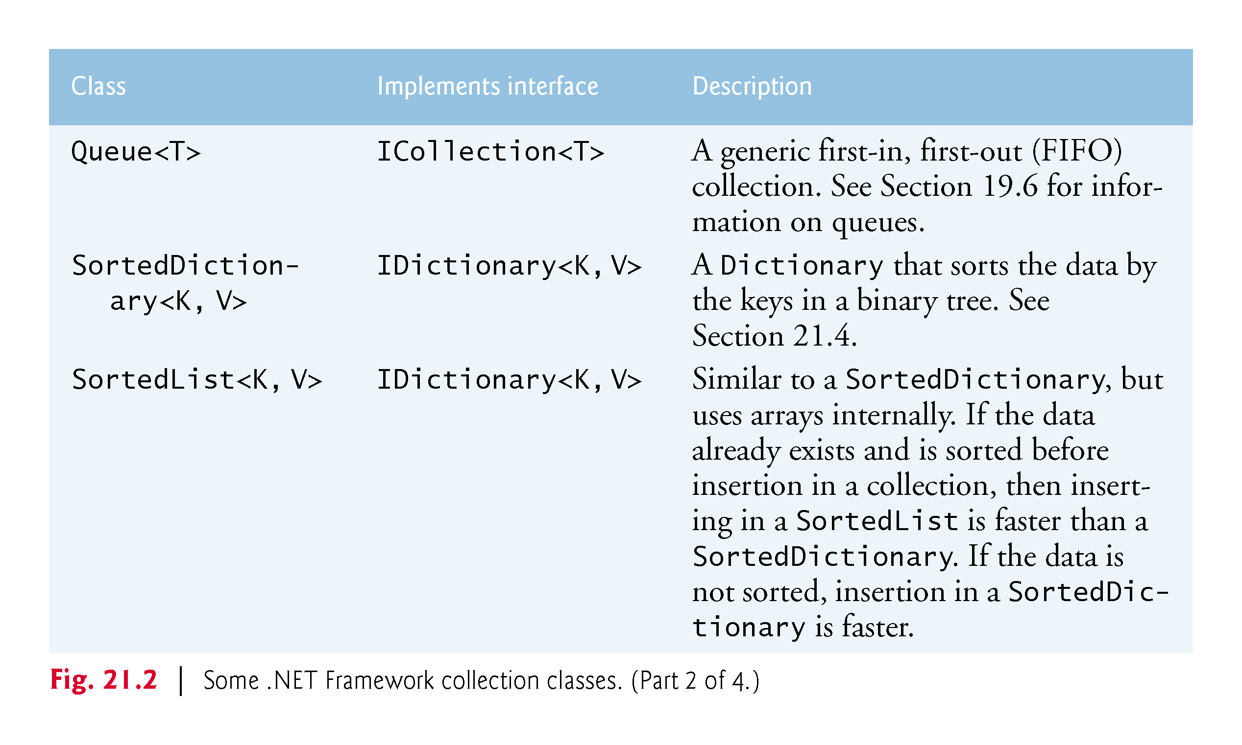

Slide 9
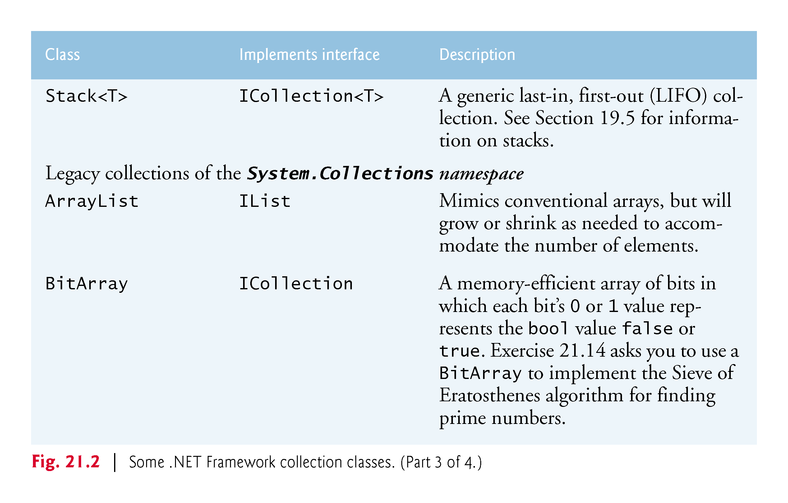

Slide 10
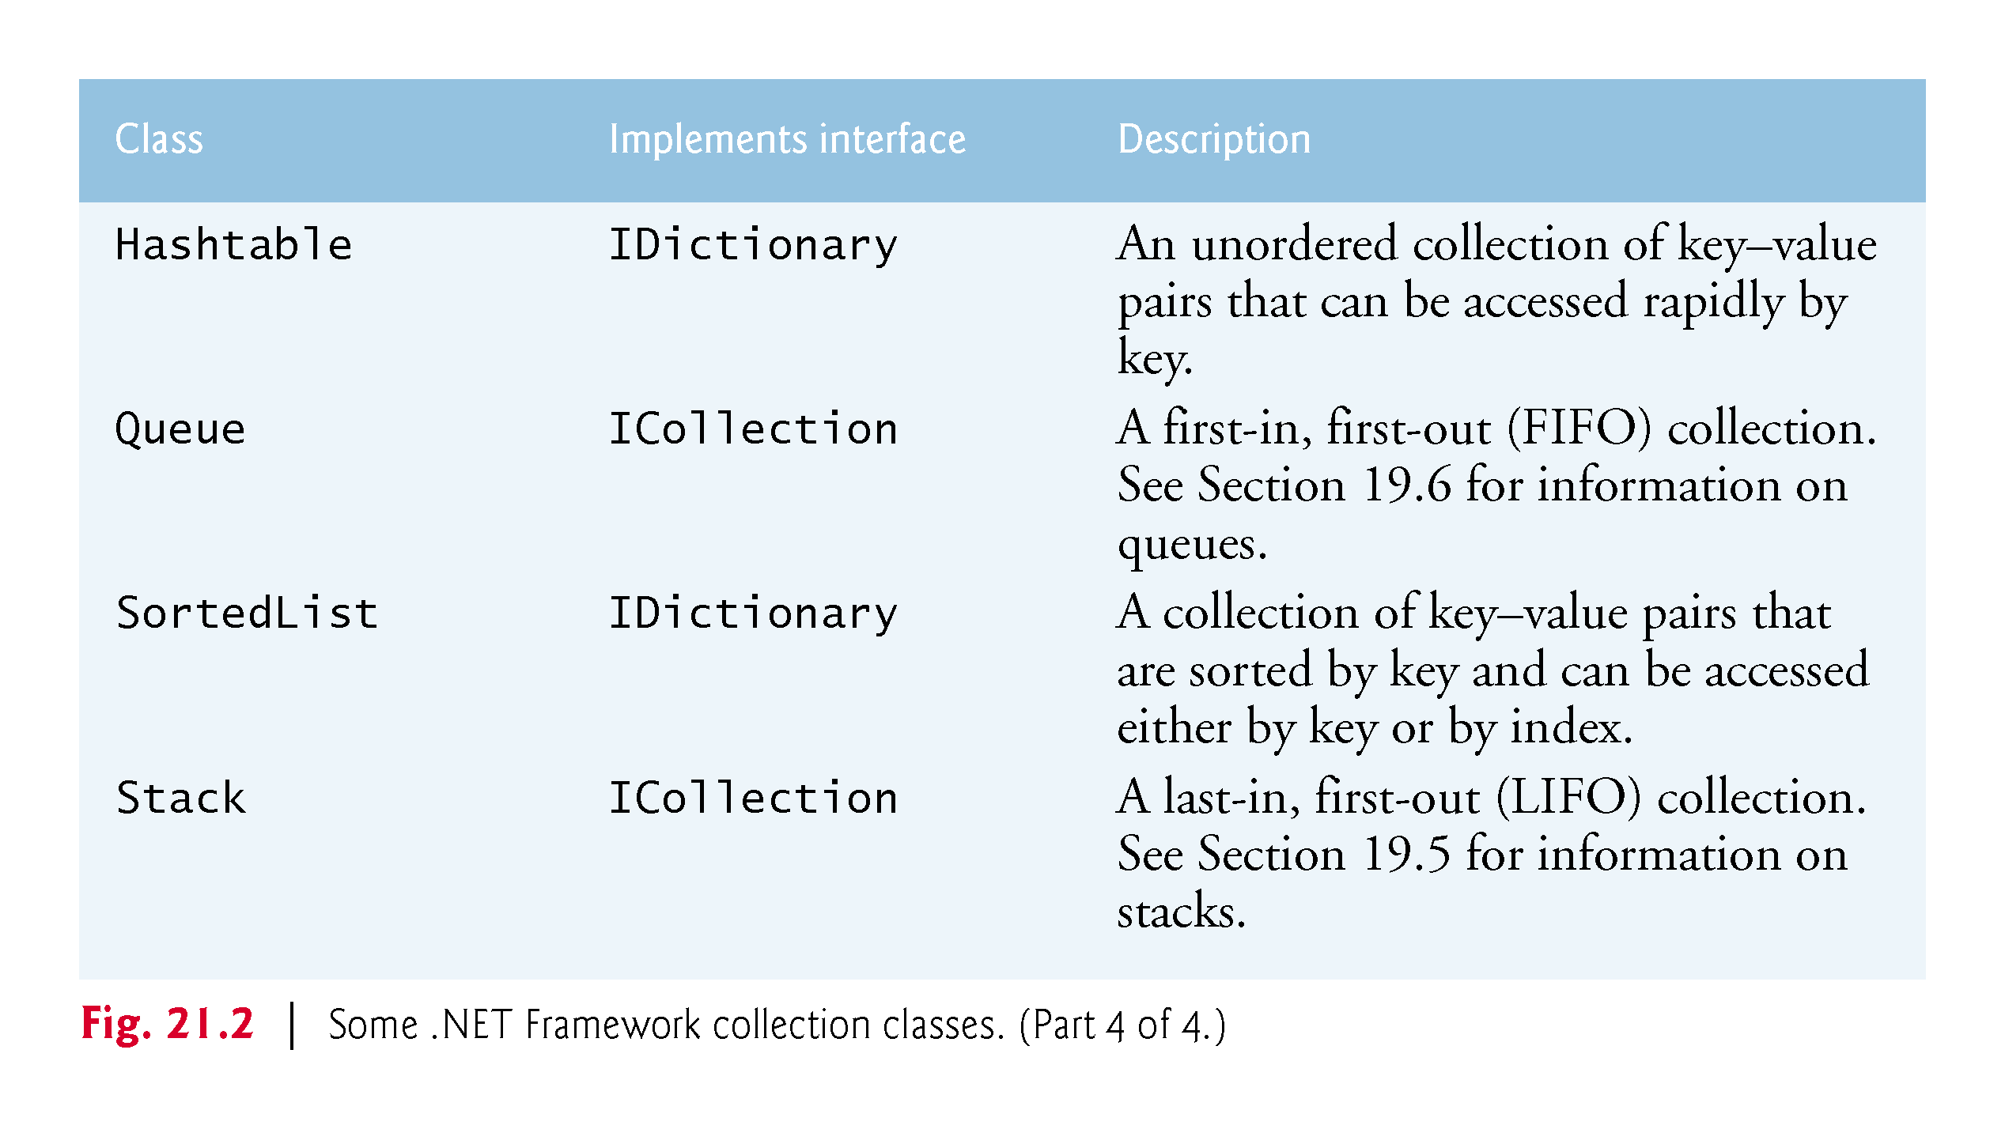

Slide 11
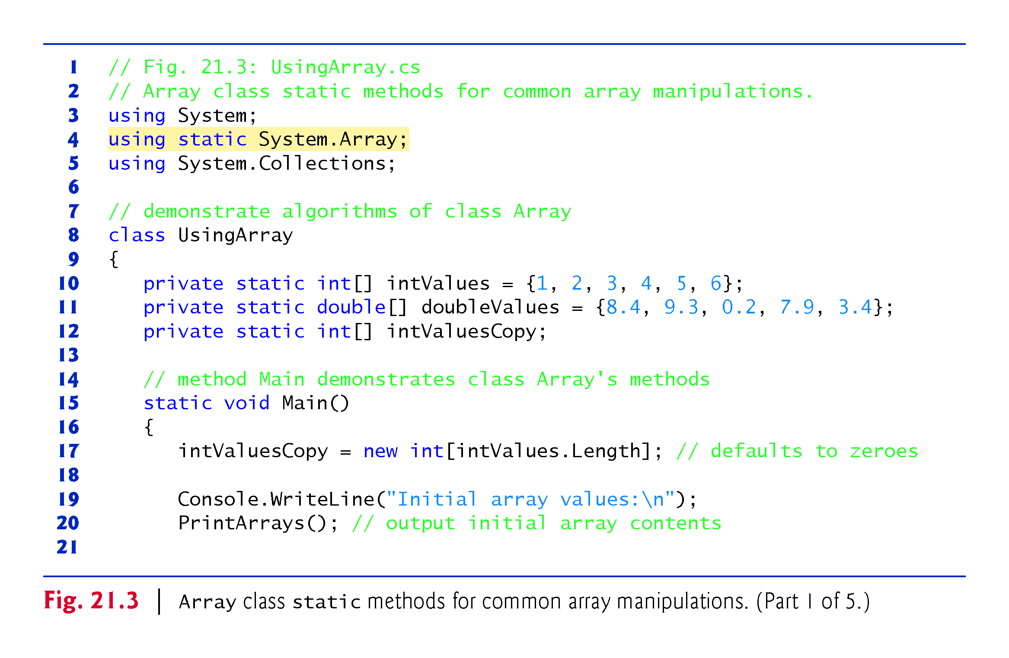
!!!

Slide 12
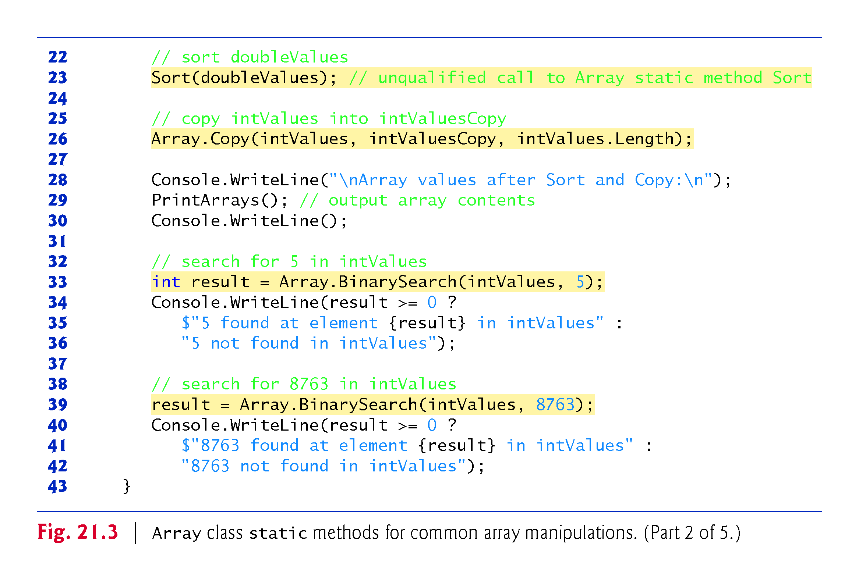
!!!
Array included in line 3
!!!

Slide 13
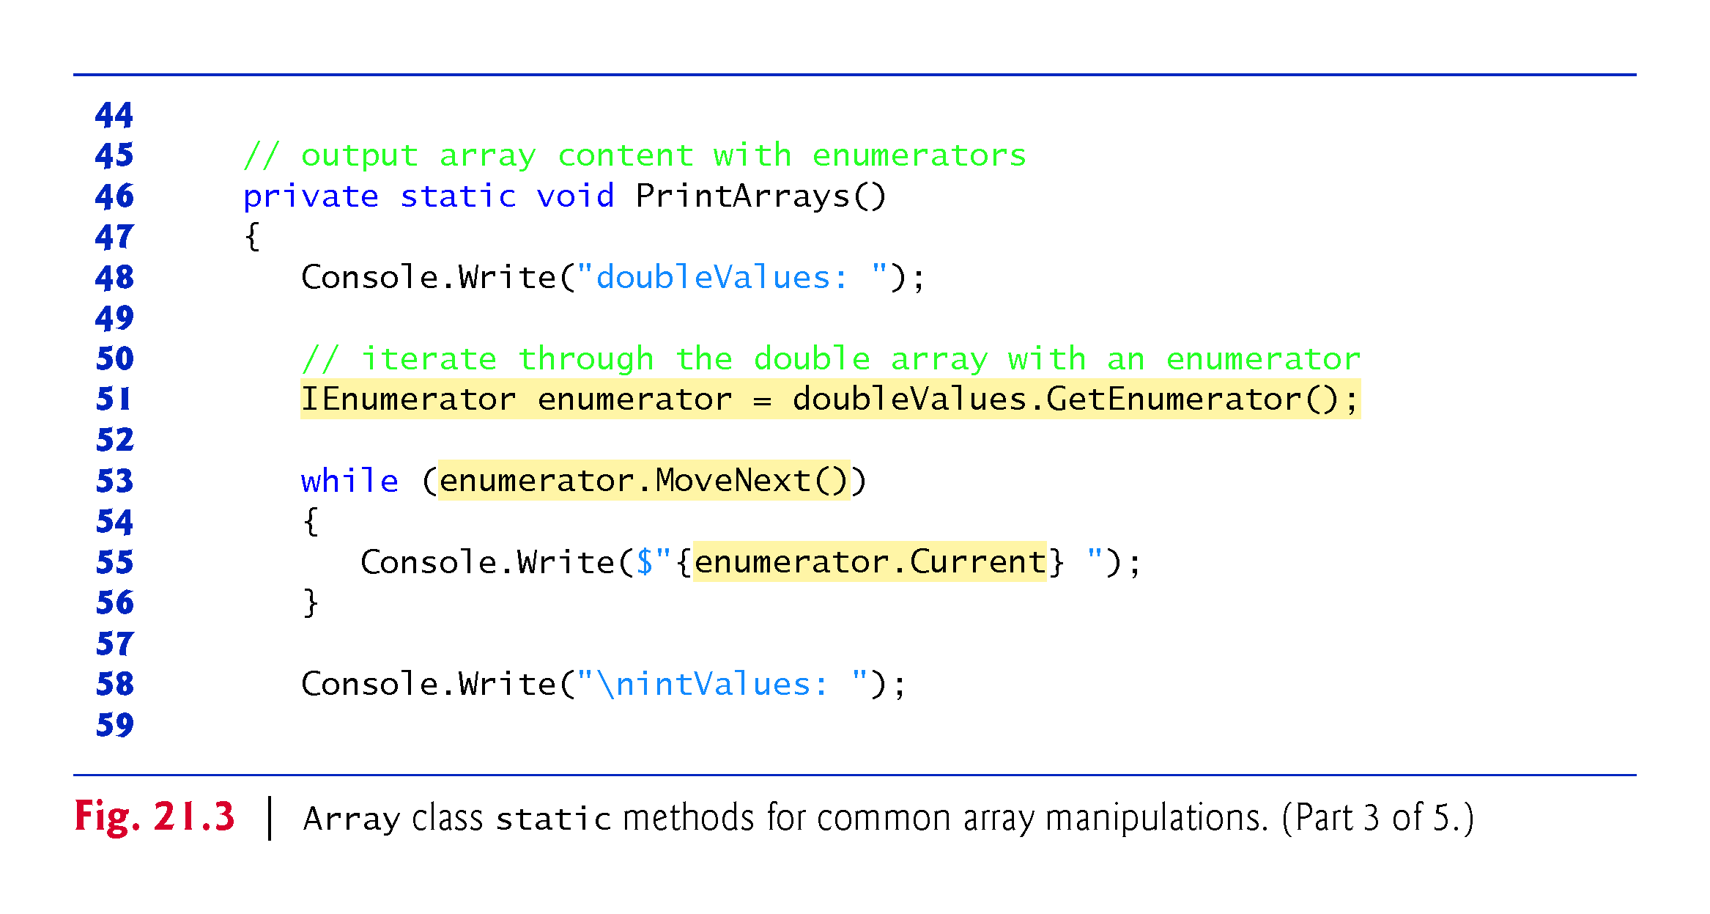
P
!!!
No more
For/foreach

Slide 14
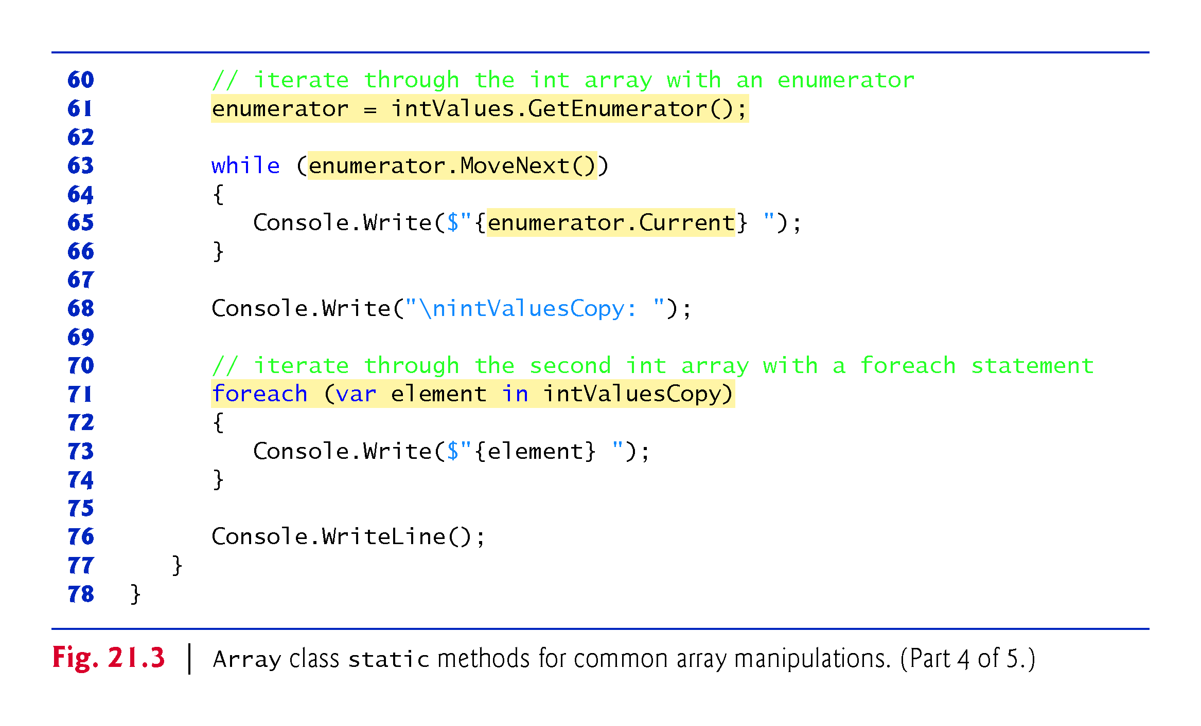
No more
For/foreach

Slide 15
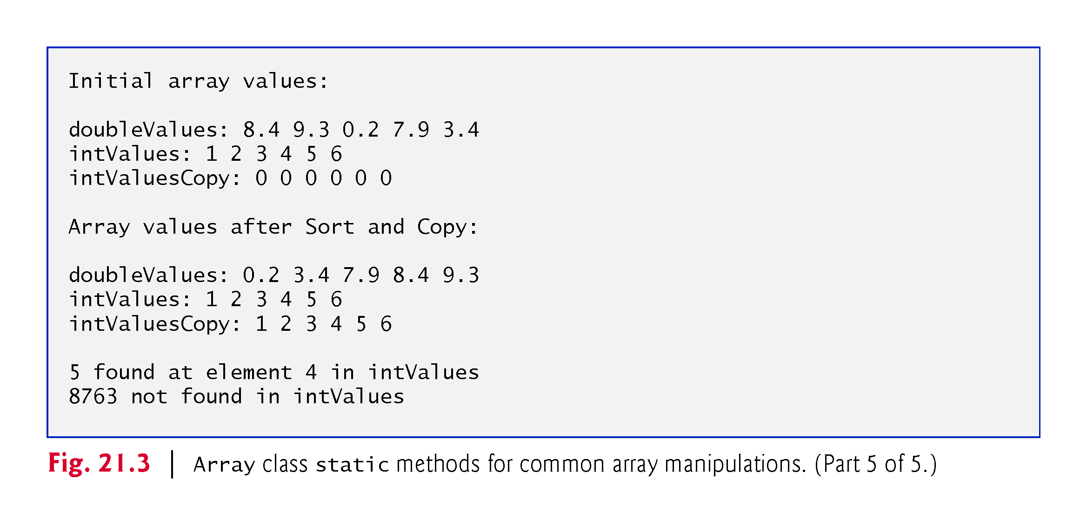

Slide 16
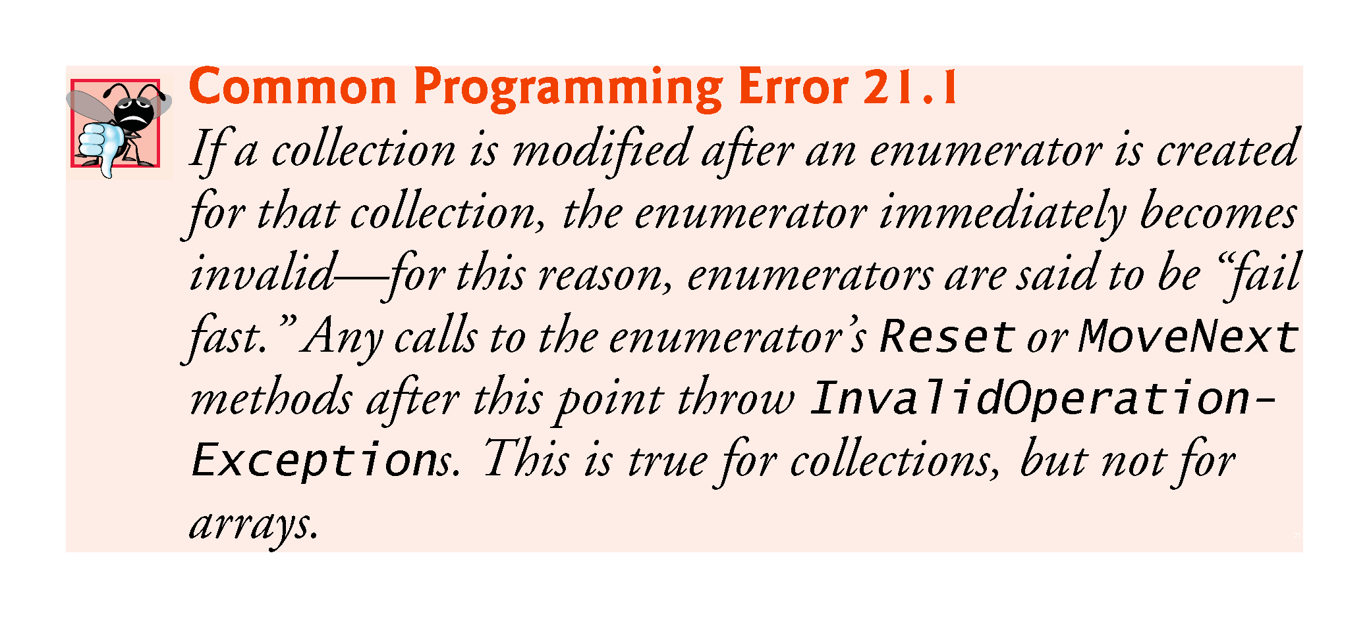

Slide 17
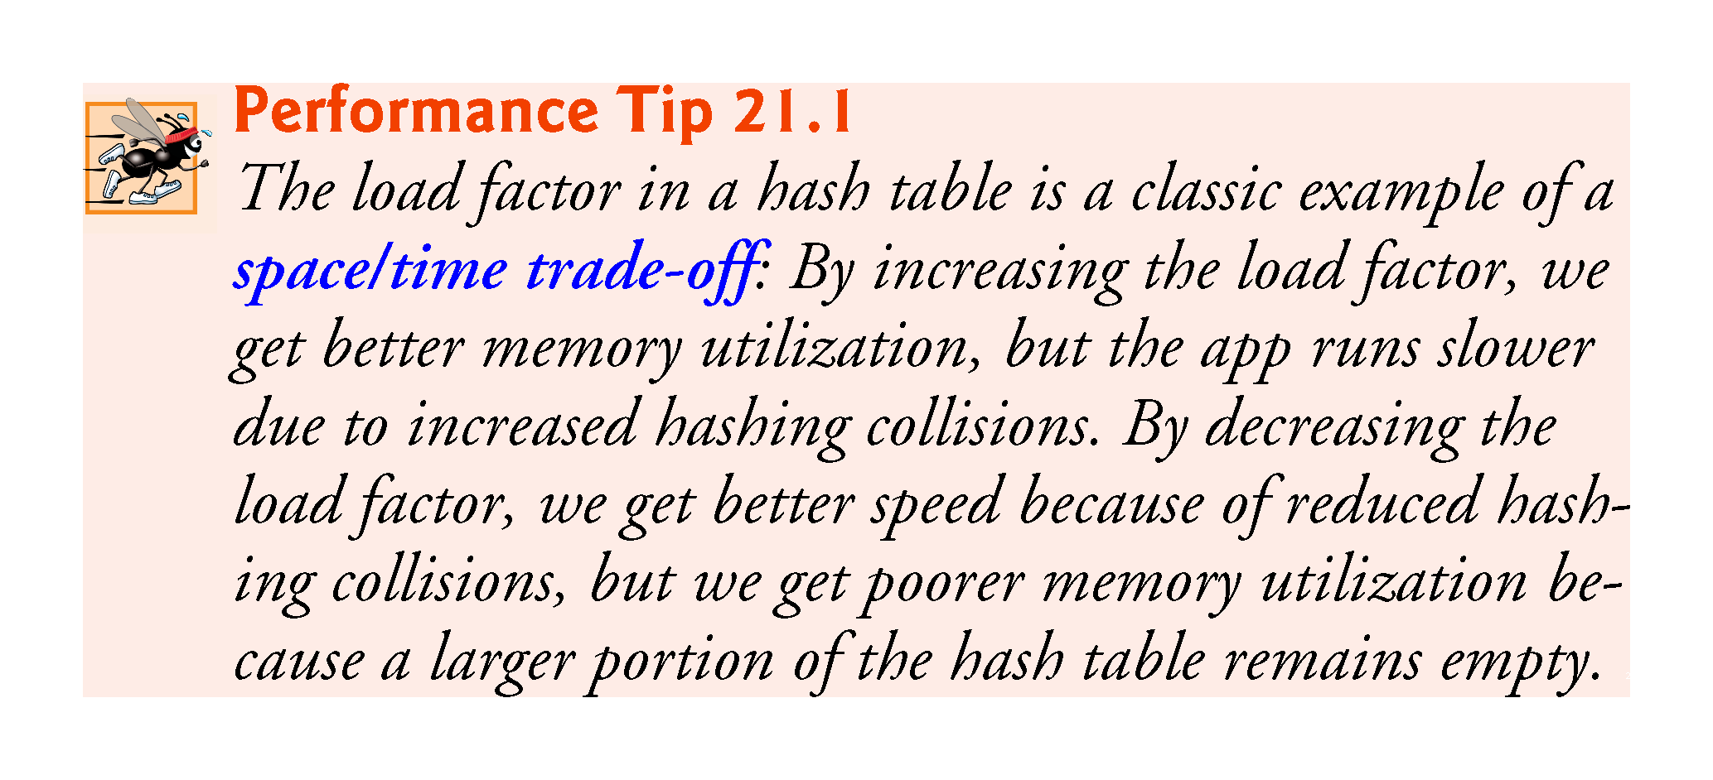

Slide 18
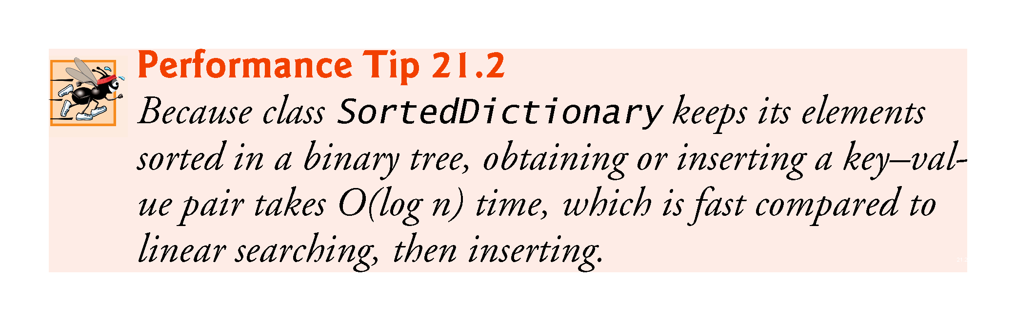

Slide 19
SortedDictionary<TKey,TValue> Class
Definition
Namespace: System.Collections.Generic
Assembly: System.Collections.dll
Represents a collection of key/value pairs that are sorted on the key.

Slide 20
SortedDictionary

Slide 21
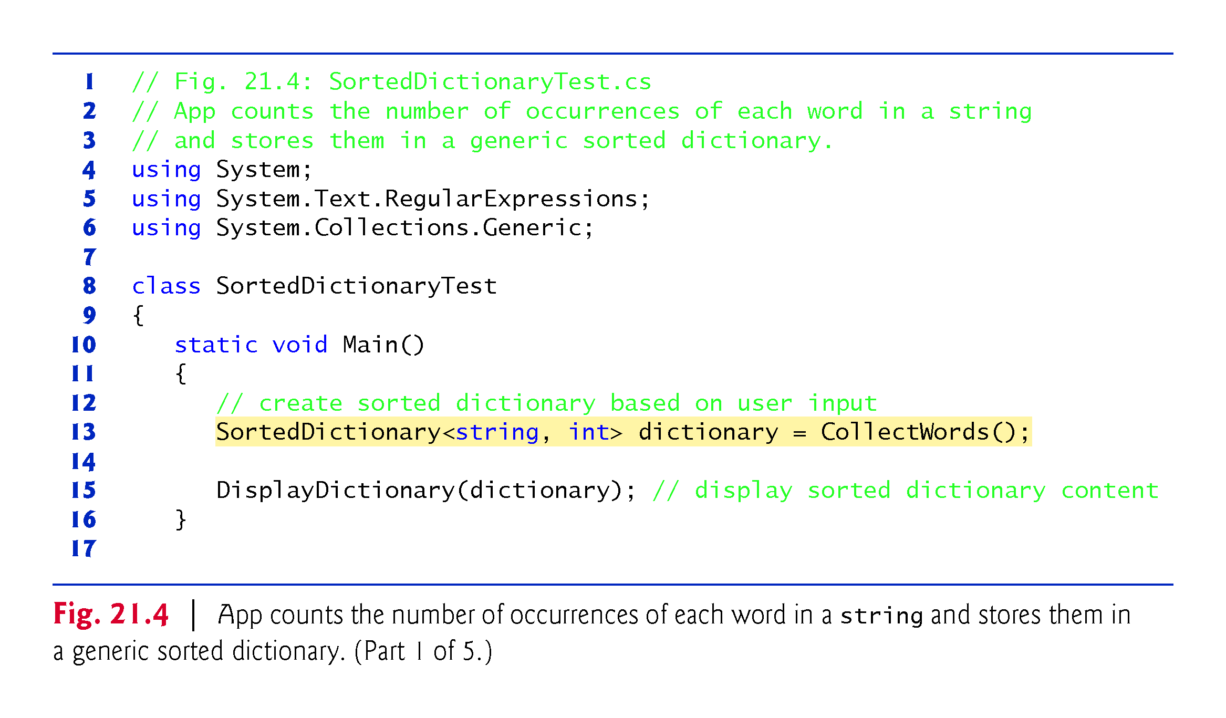

Slide 22
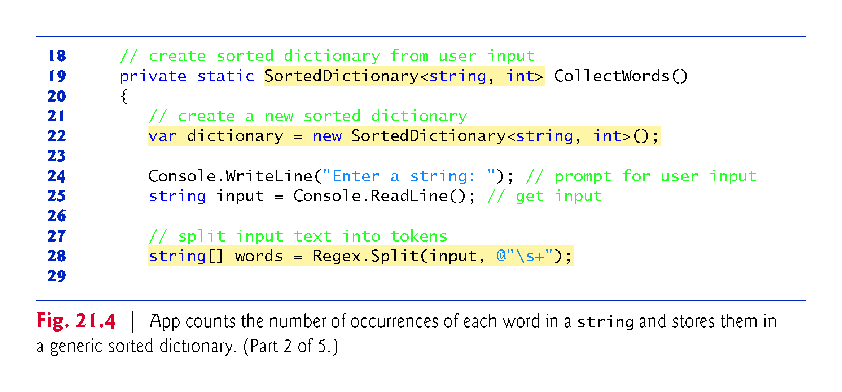
Return value
Function name
? Space or coma
Notes:
https://docs.microsoft.com/en-us/dotnet/api/system.text.regularexpressions.regex?view=net-5.0
https://docs.microsoft.com/en-us/dotnet/api/system.text.regularexpressions.regex.split?view=net-5.0

Slide 23
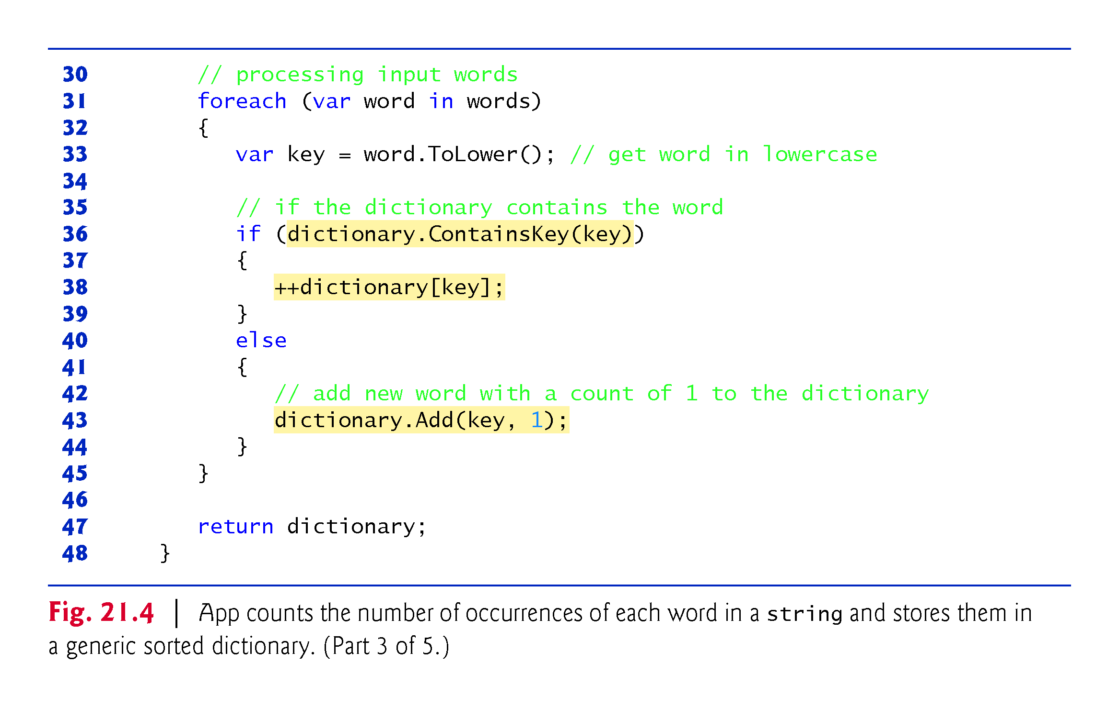

Slide 24
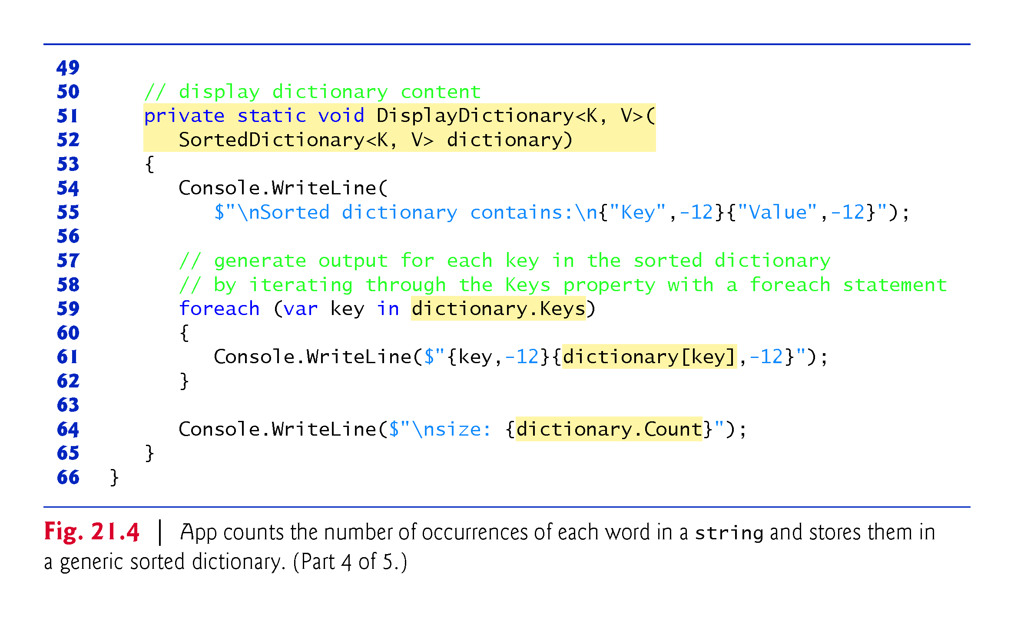
key
value
key
value
size

Slide 25
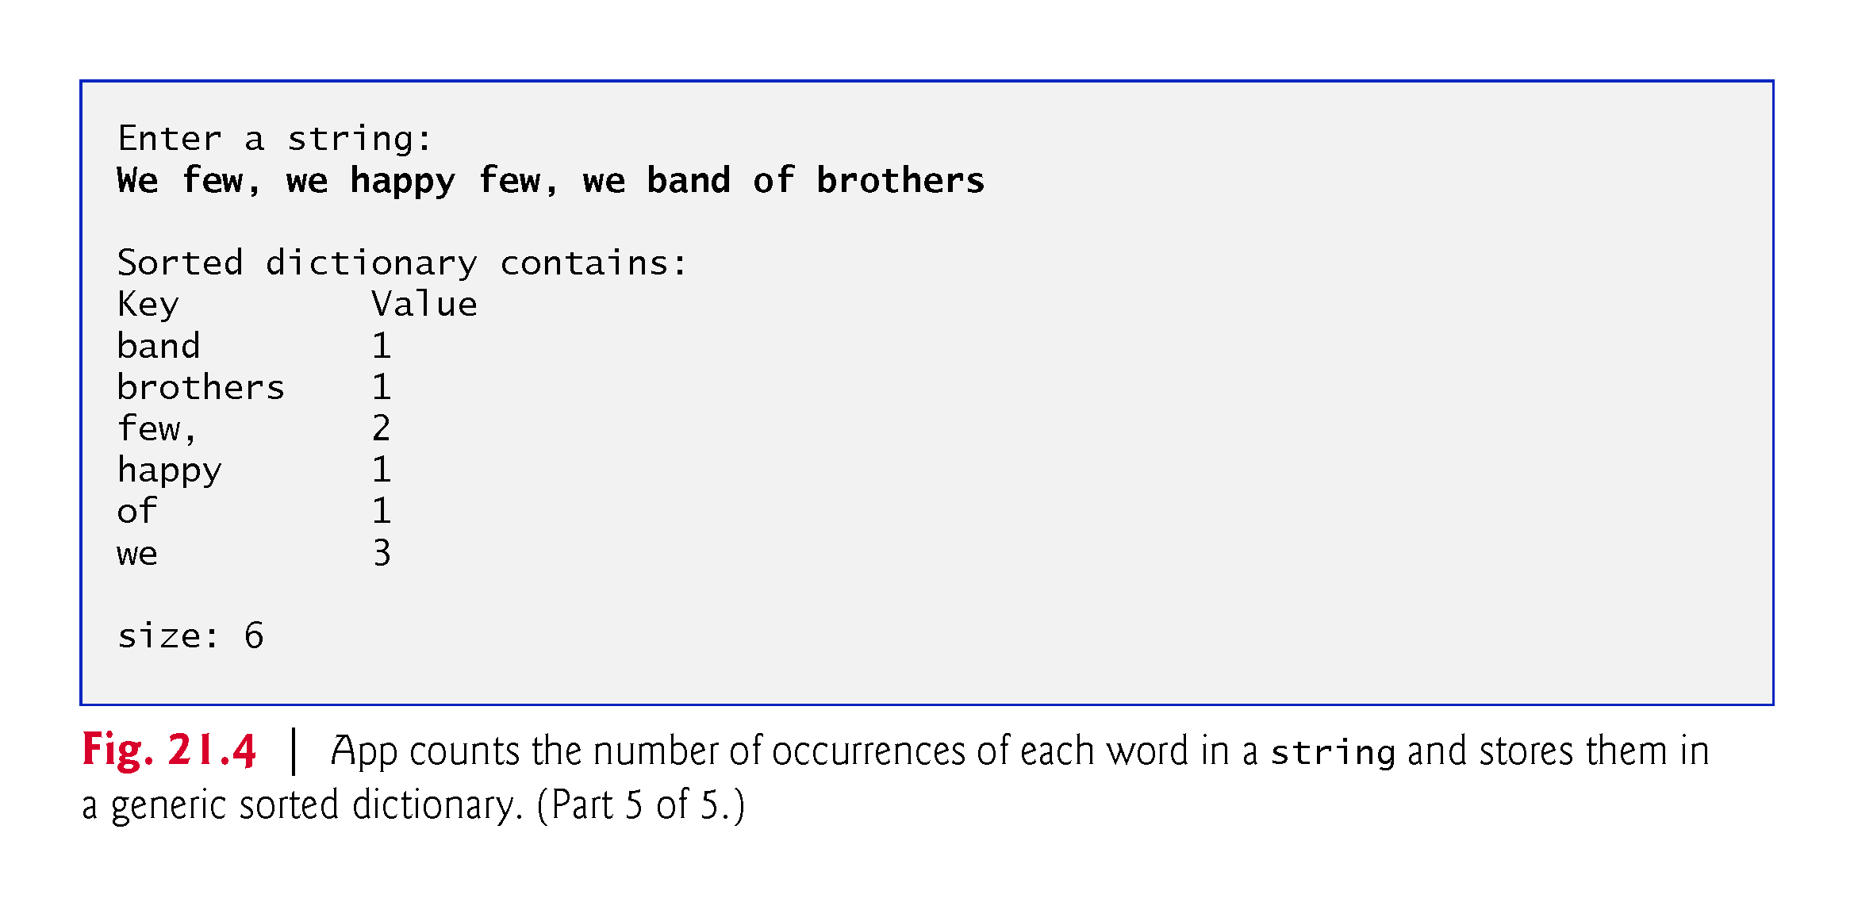

Slide 26
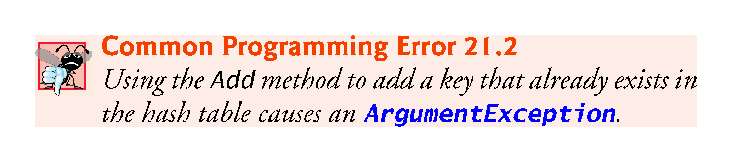

Slide 27
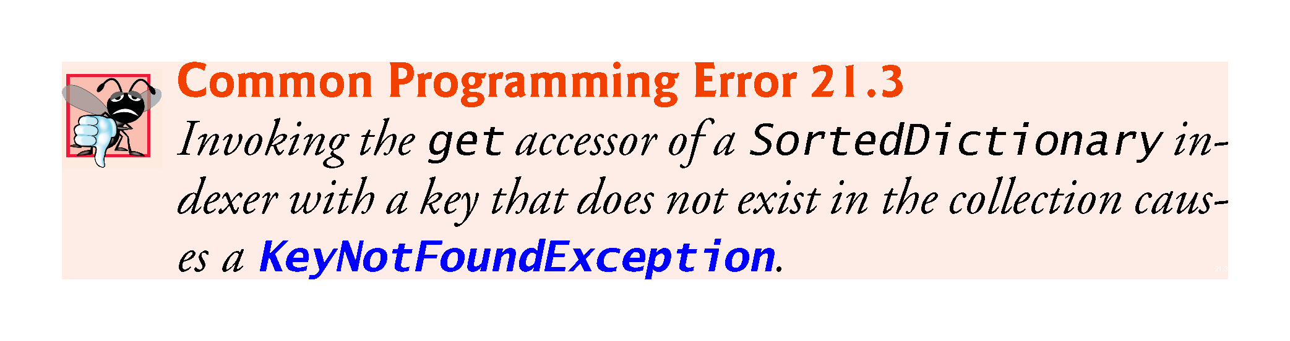

Slide 28
LinkedList

Slide 29
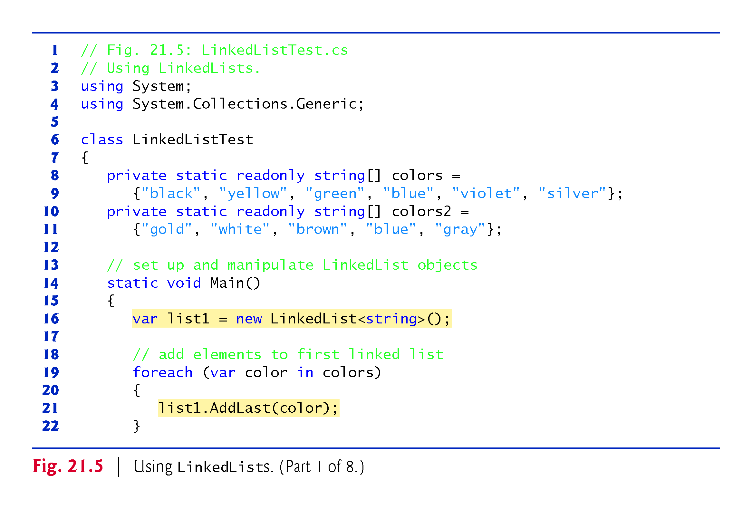

Slide 30
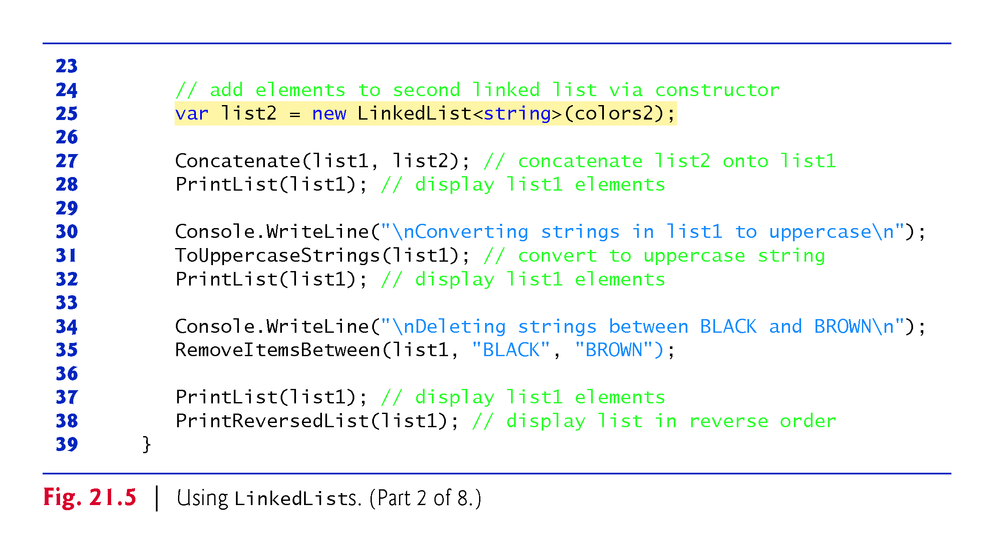
!!!
!!!
!!!
!!!

Slide 31
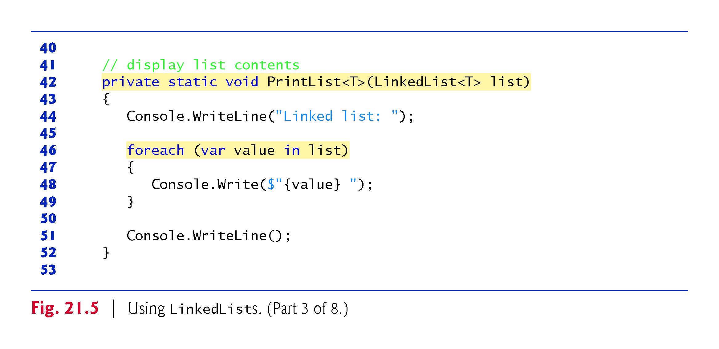

Slide 32
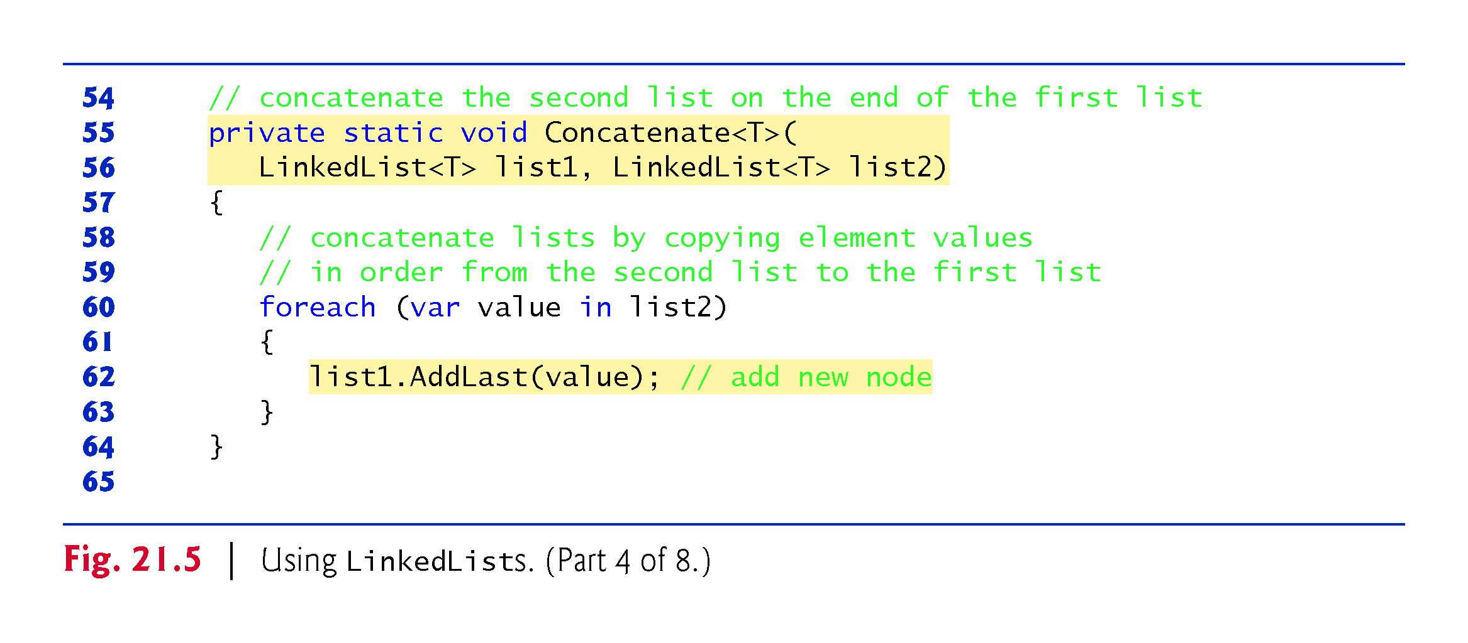
!!!
Call by reference, change list1 value
!!!

Slide 33
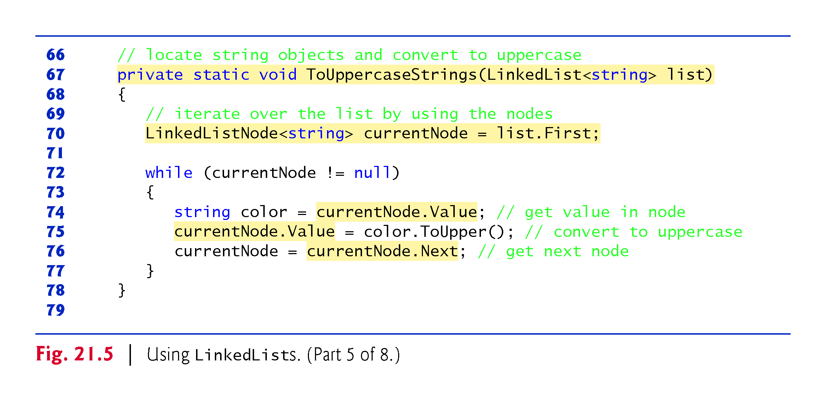

Slide 34
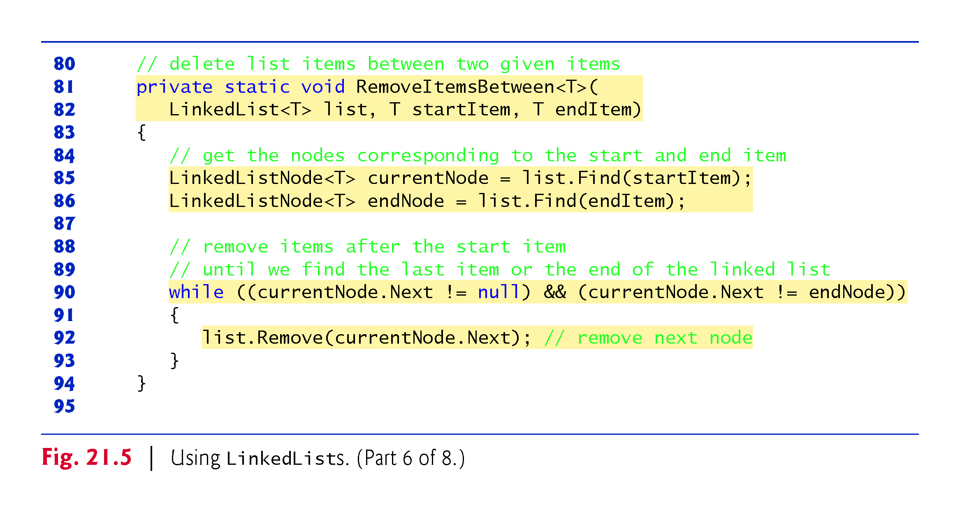
P what is going on
!!!
!!!

Slide 35
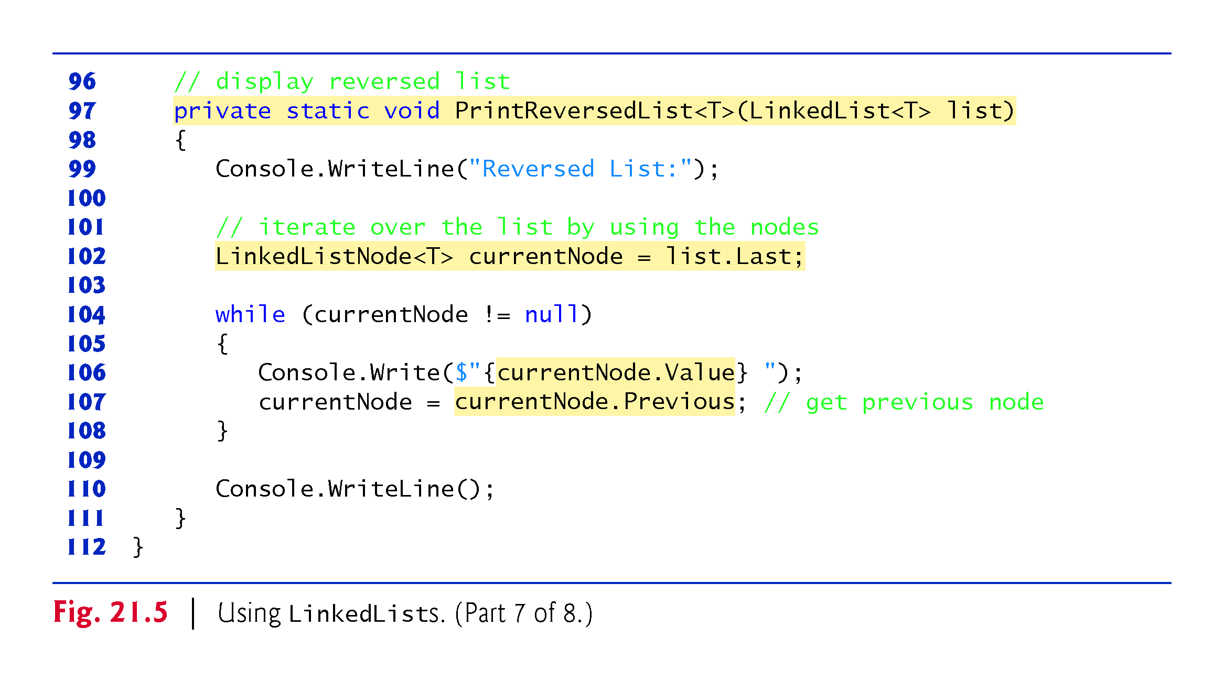
P what is going on

Slide 36
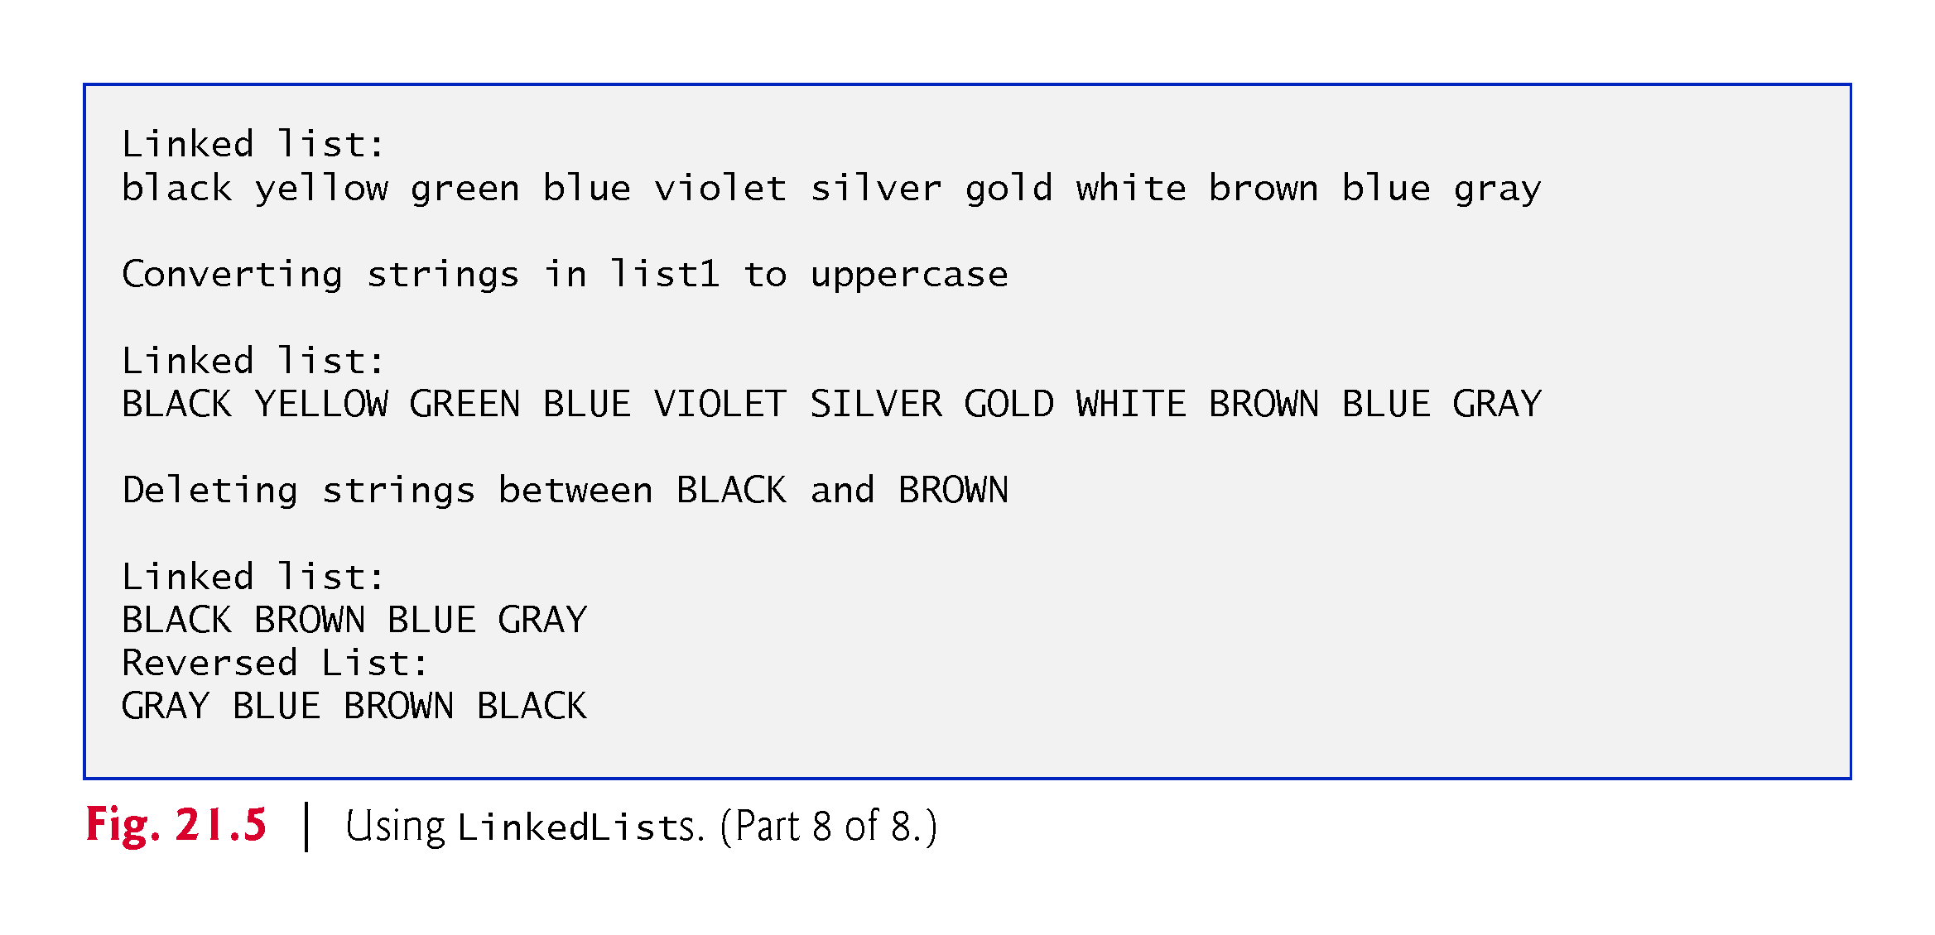

Slide 37
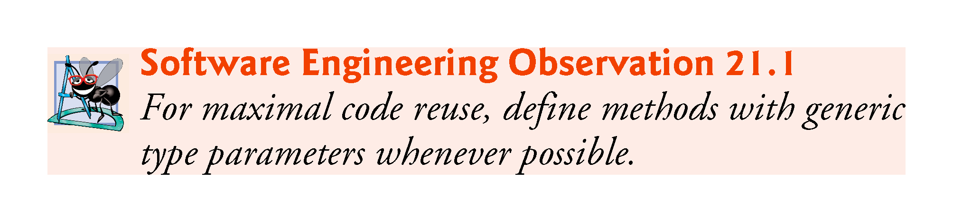

Slide 38
delegation

Slide 39
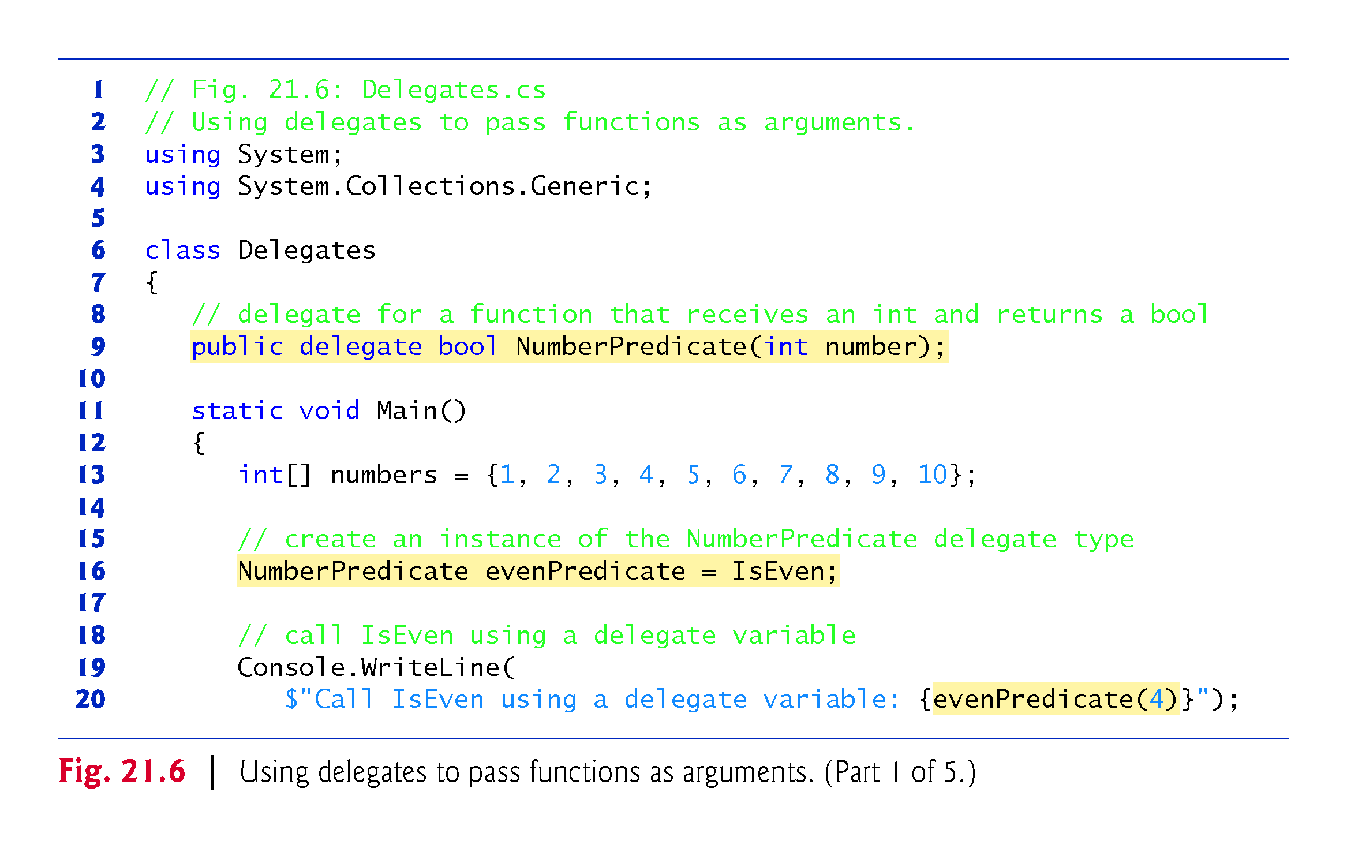
p
Any function that has this signature can be used as delegate to pass to another function!!!
Declare function as a variable, as it will be passed to a function
Notes:
Predicate谓词
Wèicí

Slide 40
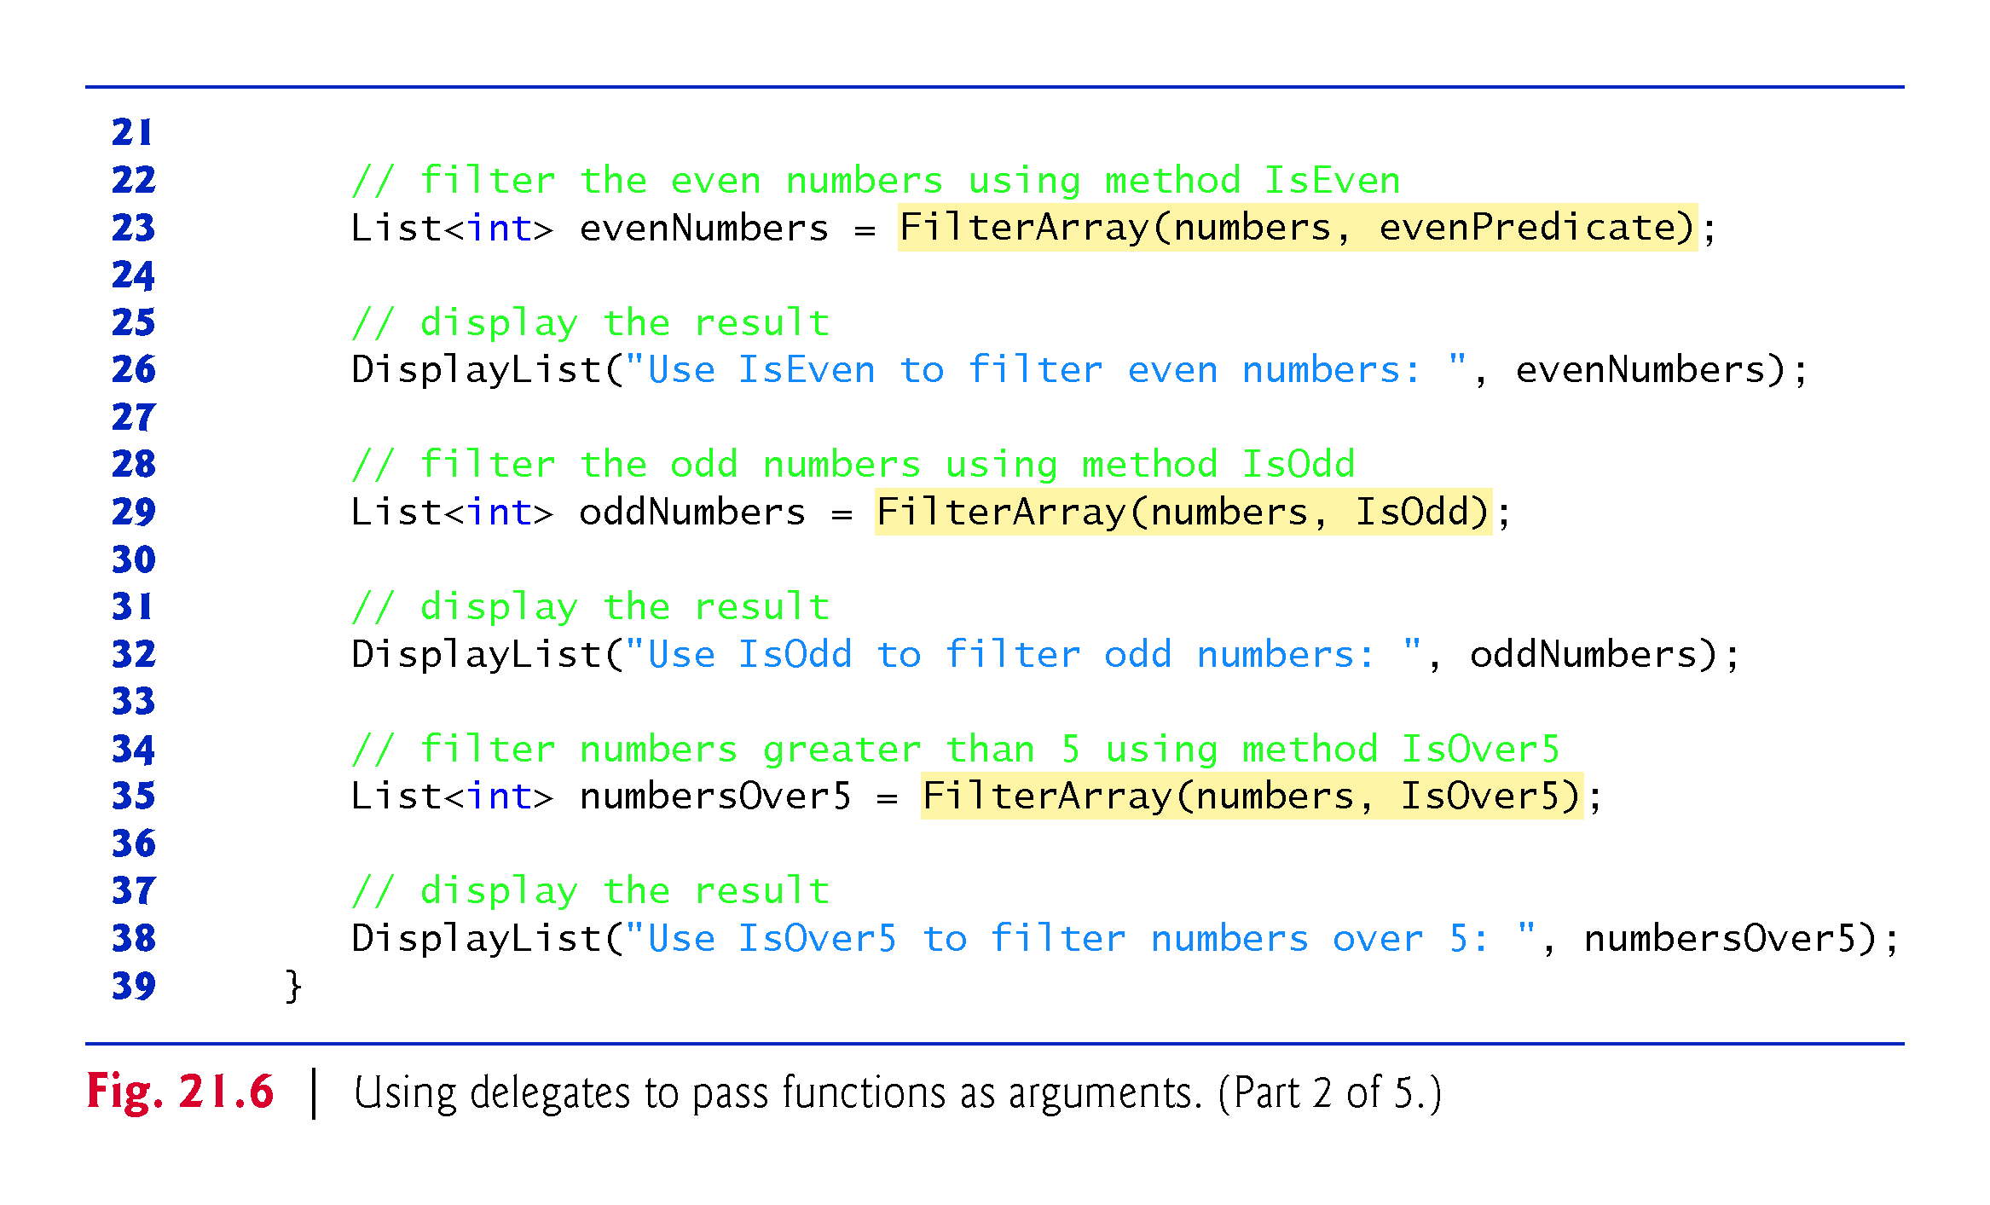
evenPredicate = IsEven

Slide 41
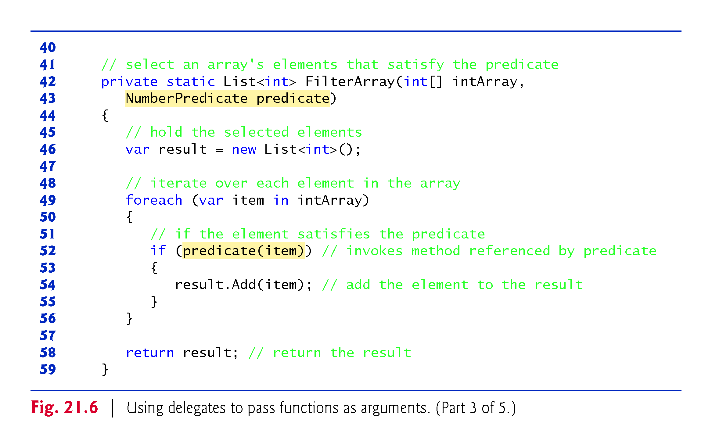

Slide 42
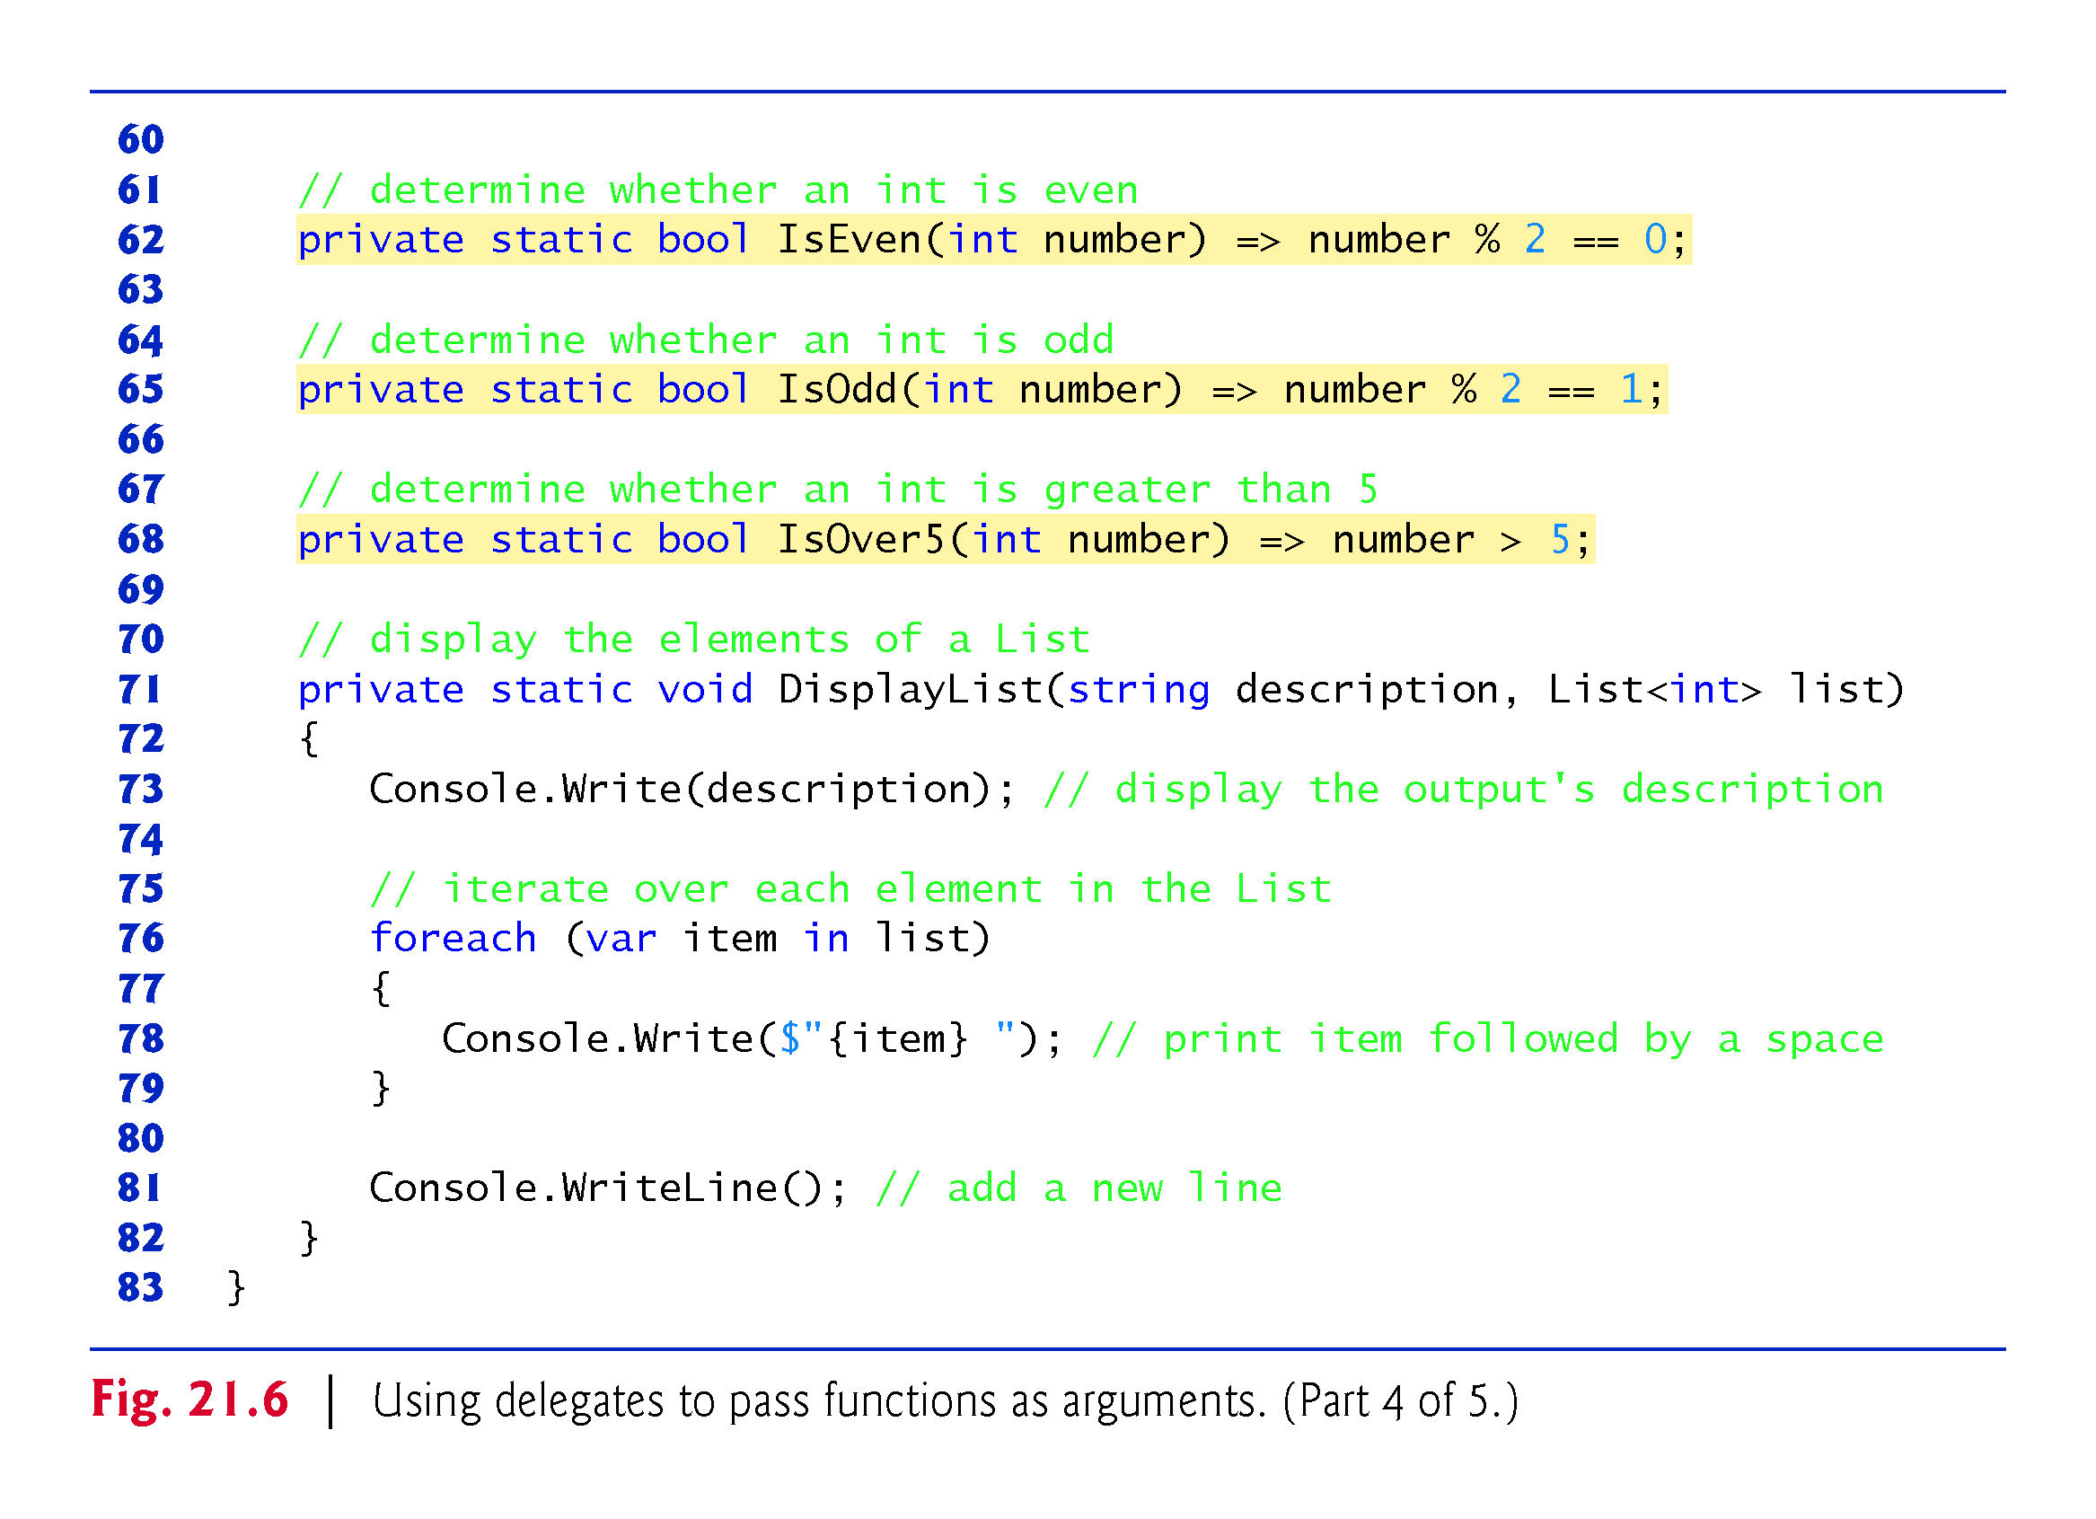

Slide 43
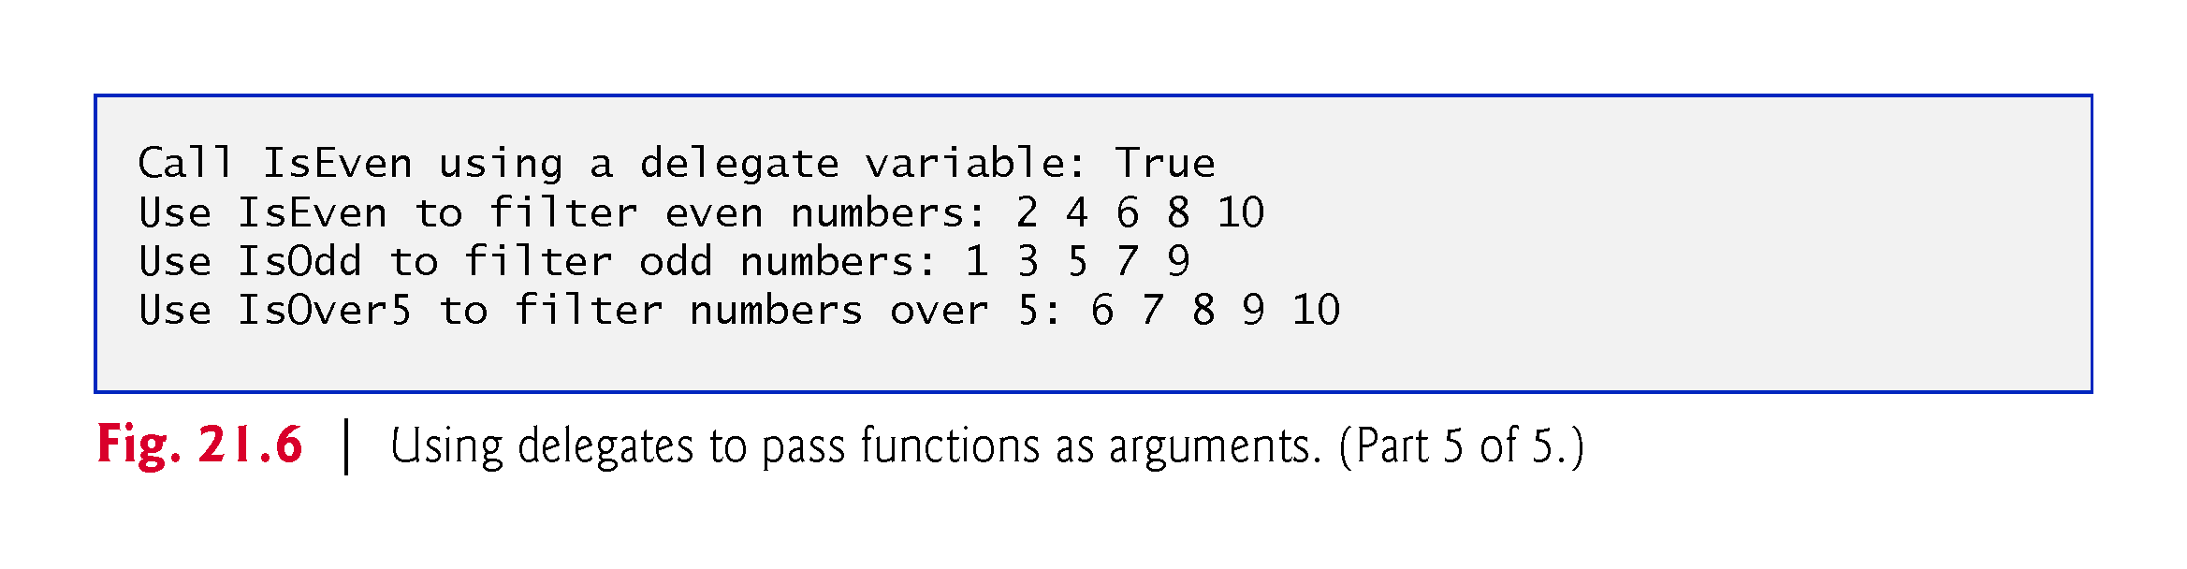

Slide 44
Delegation& lambda expression

Slide 45
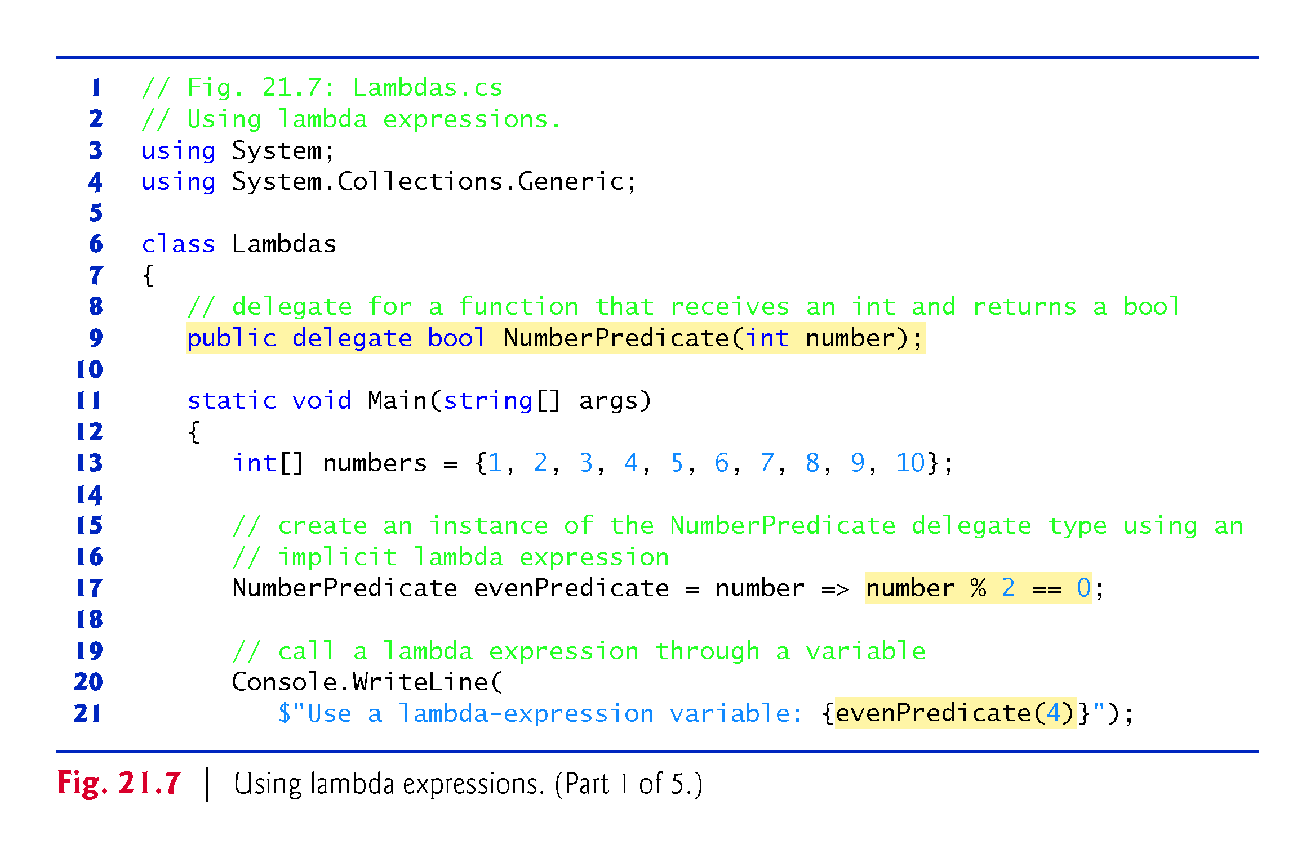
implicitly typed lambda expression, no type indicated for “number”
number is input, number%2==0, then return true
No name for function→f(number)

Slide 46
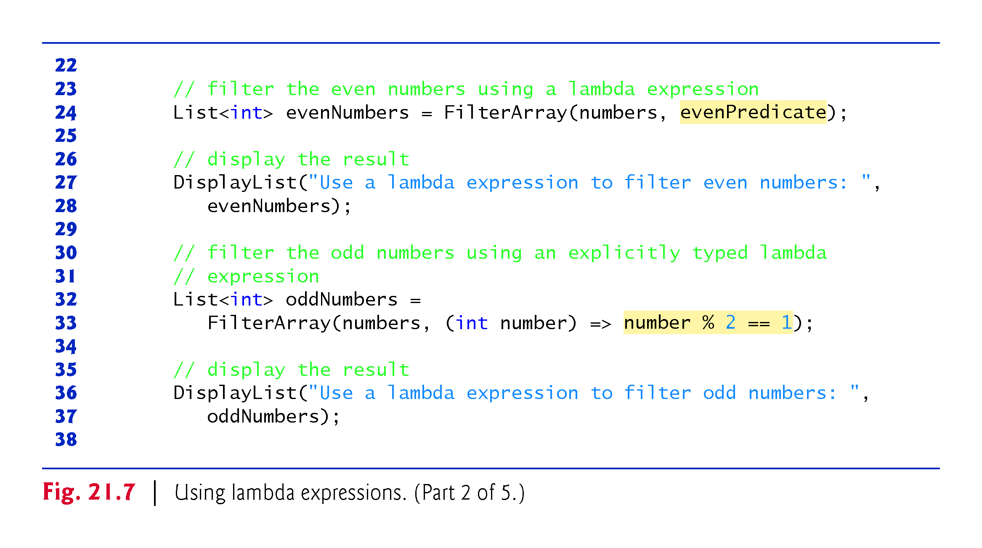
Explicitly typed lambda expression
OddPredicate?
number is input, f(number), number%2==1, then return true

Slide 47
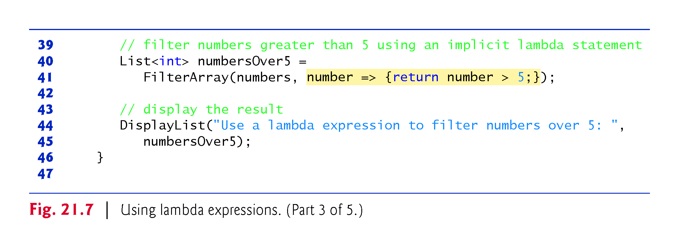

Slide 48
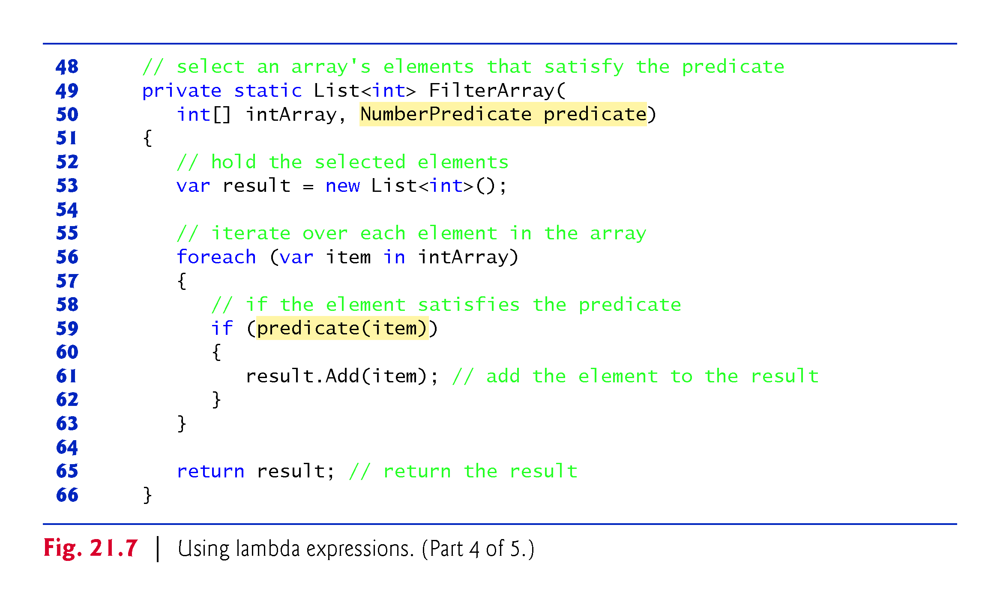

Slide 49
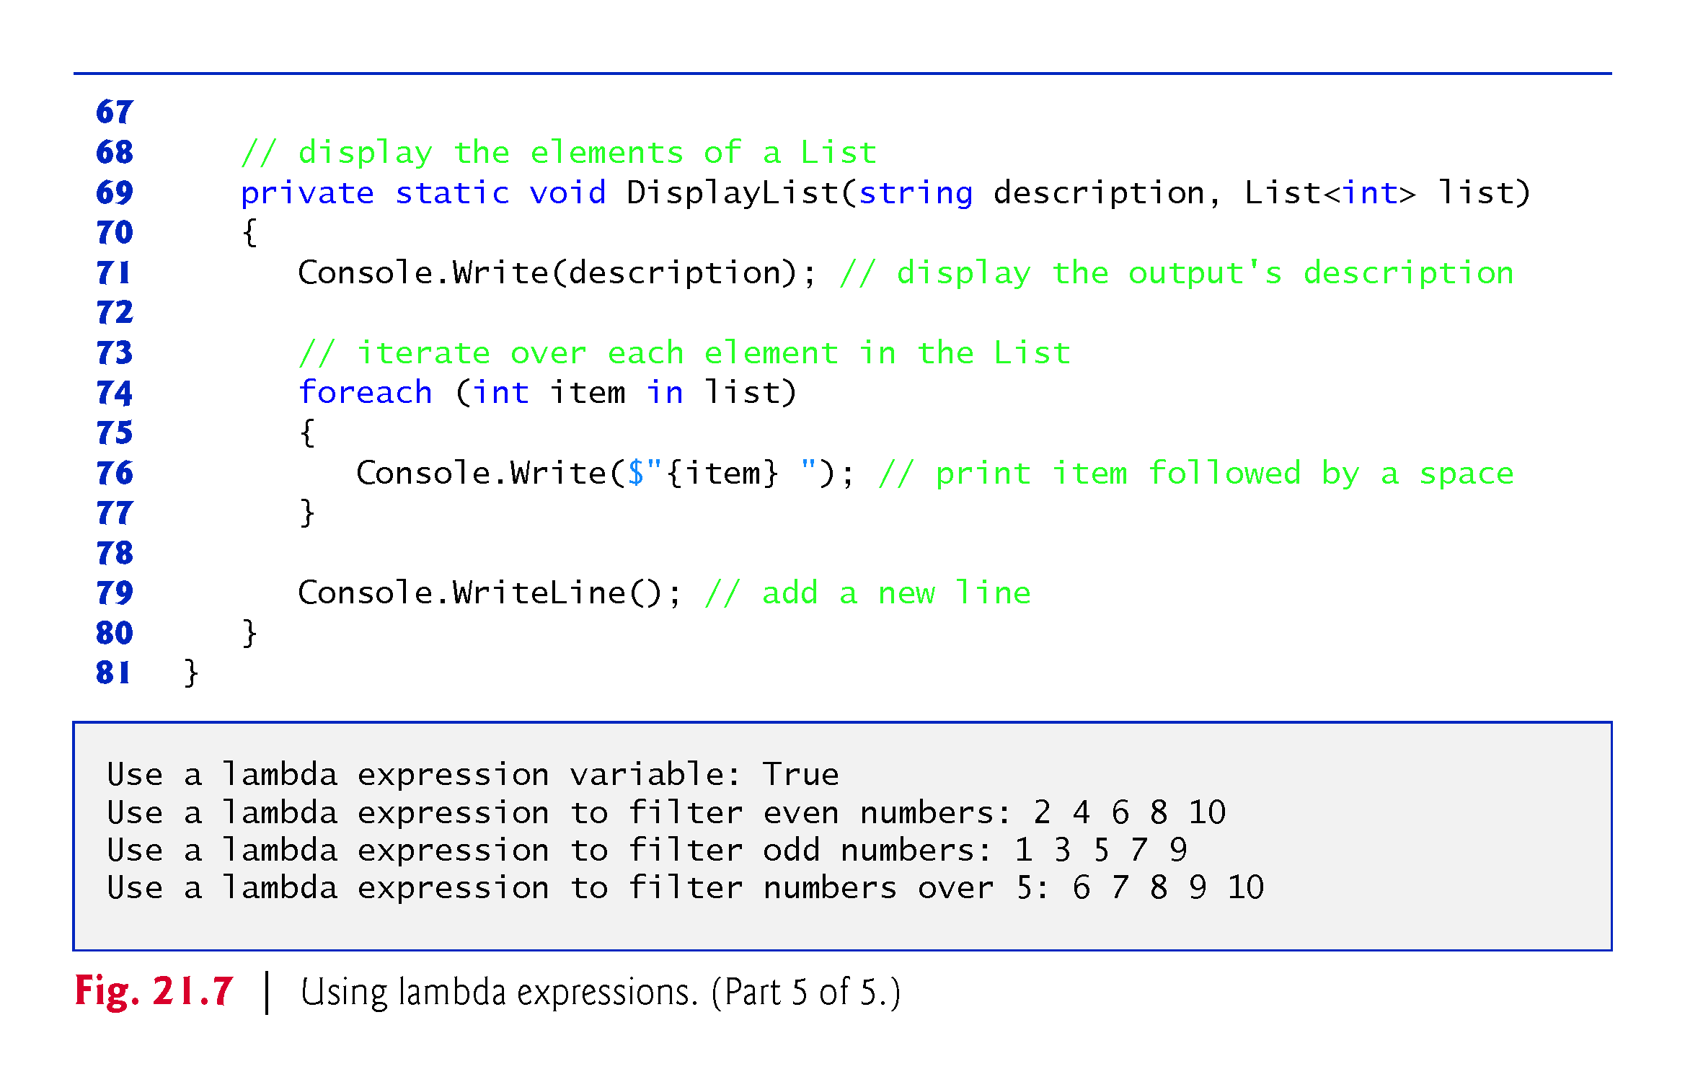

Slide 50
Aggregate method in C#

Slide 51
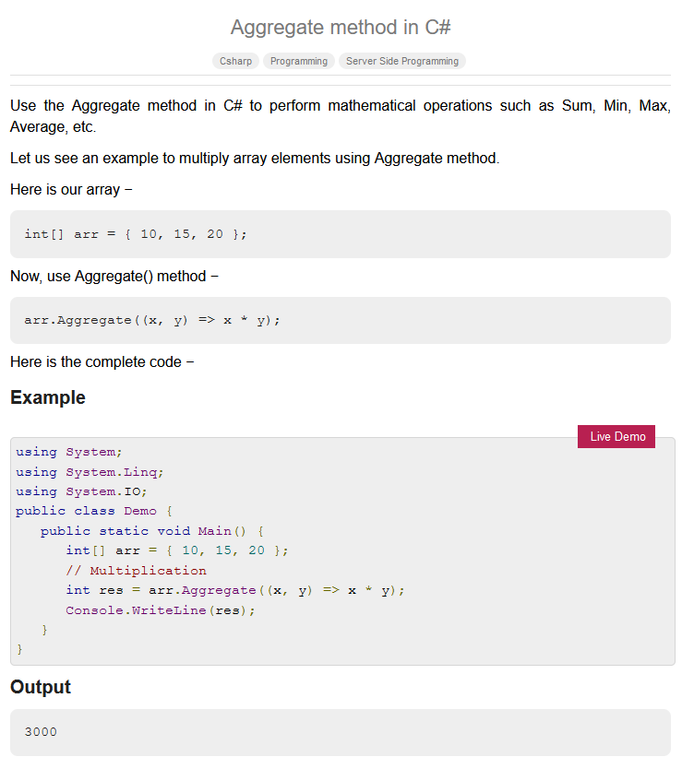

Slide 52
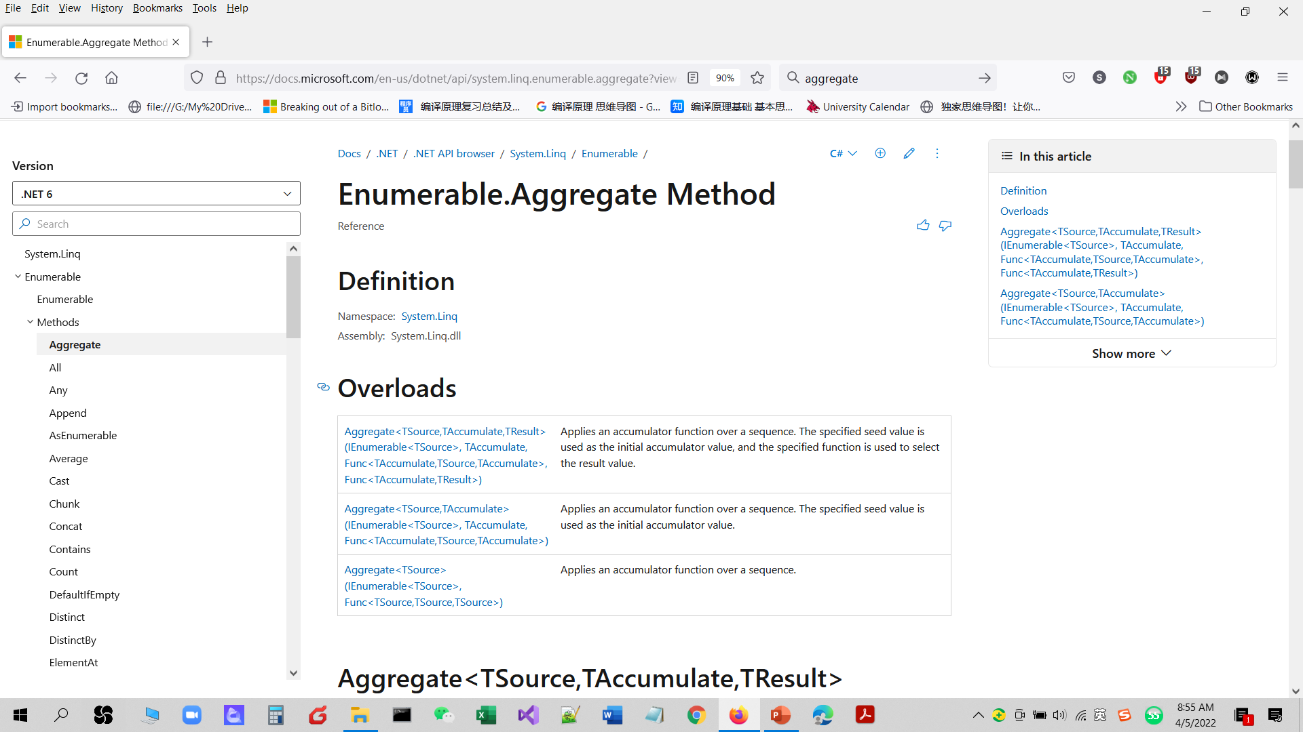

Slide 53
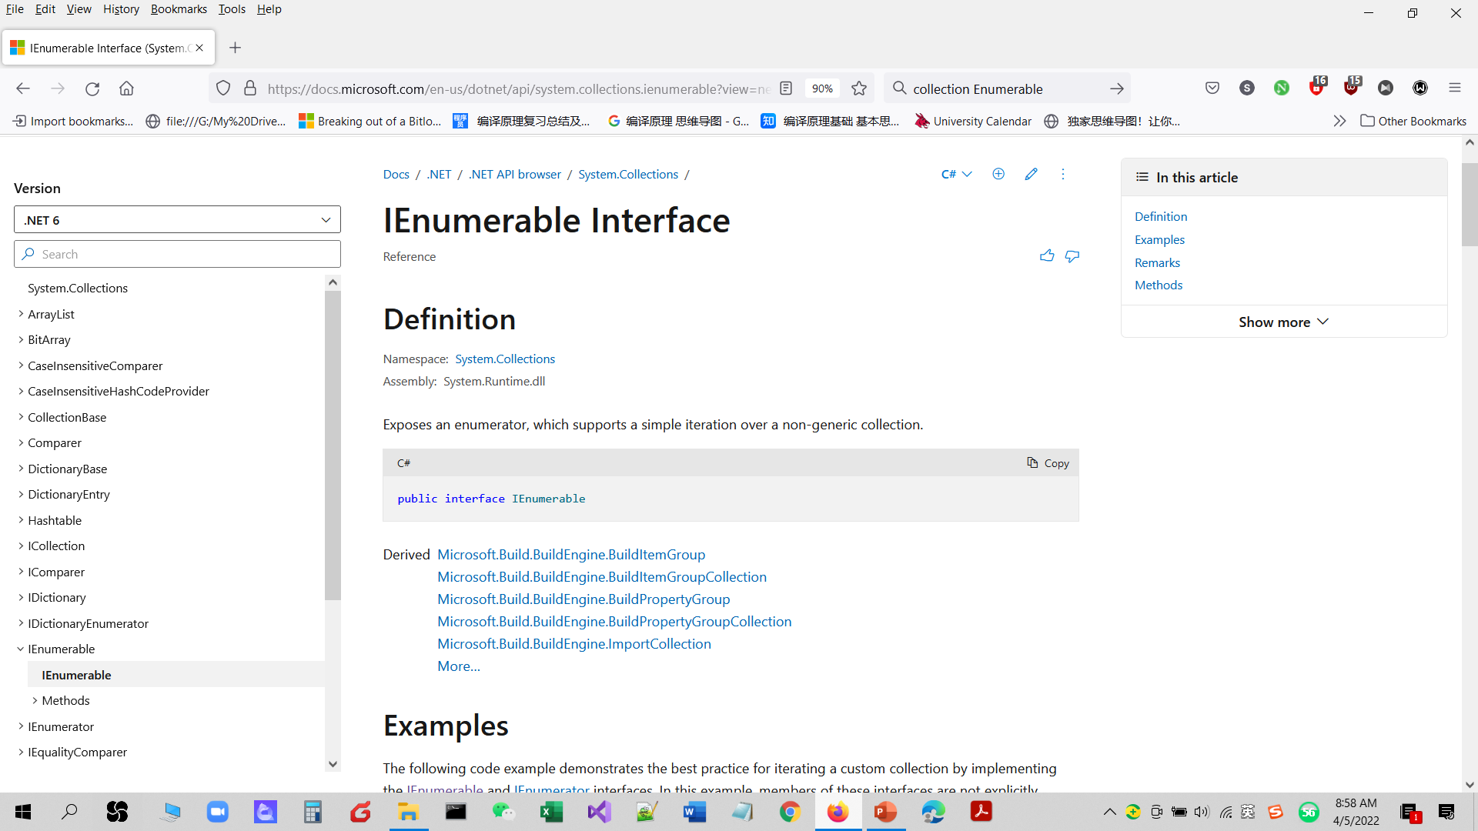
IEnumerable is the base interface for all non-generic collections?? that can be enumerated.
Notes:
https://docs.microsoft.com/en-us/dotnet/api/system.collections.ienumerable?view=net-6.0

Slide 54
IEnumerable is the base interface for all non-generic collections??
Aggregate is the method of IEnumerable
Aggregate is the method of collections

Slide 55
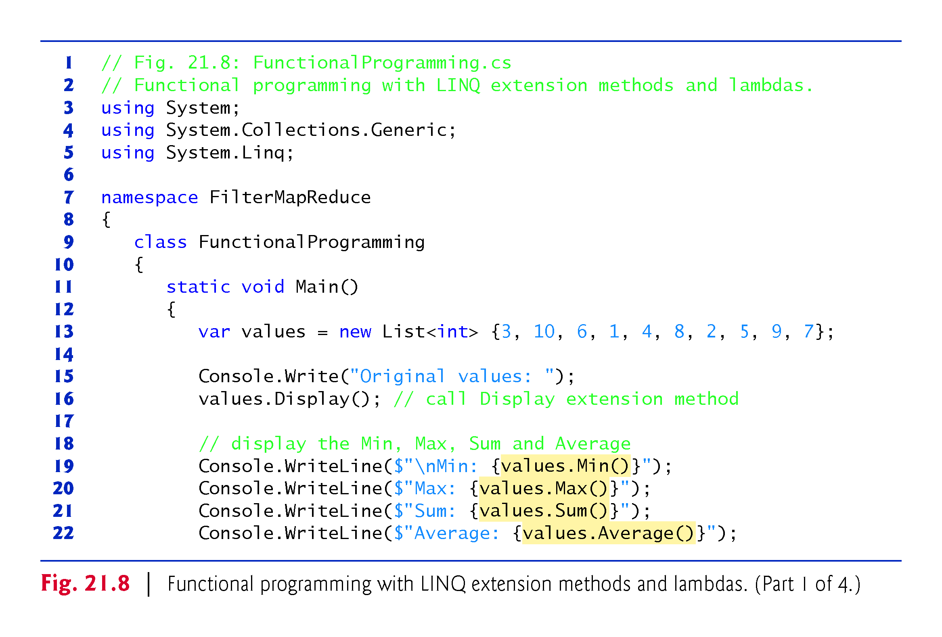

Slide 56
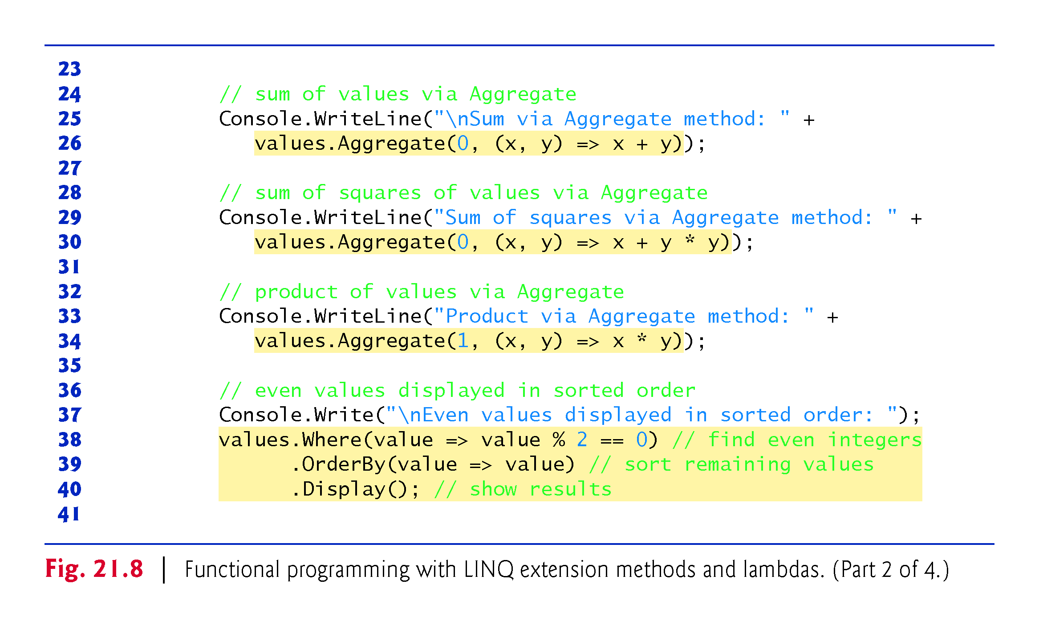
P:output
!!!
Notes:
https://www.tutorialspoint.com/aggregate-method-in-chash

Slide 57
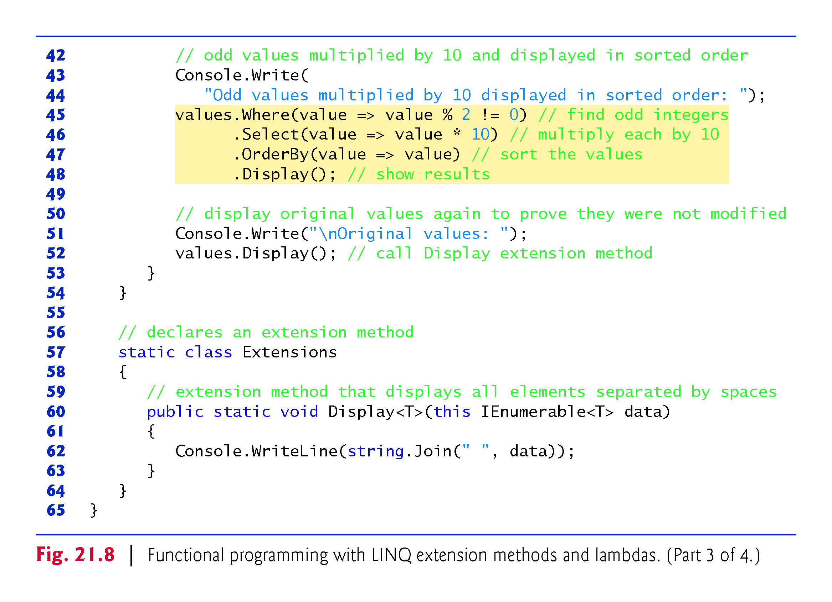
??
Display() is the function of which class???
Extension to the existing IEnumerable,
Ienumerable is the super class for collection

Slide 58
Purpose: List<T> is a class that implements the IEnumerable<T>, ICollection<T>, and IList<T> interfaces.

Slide 59
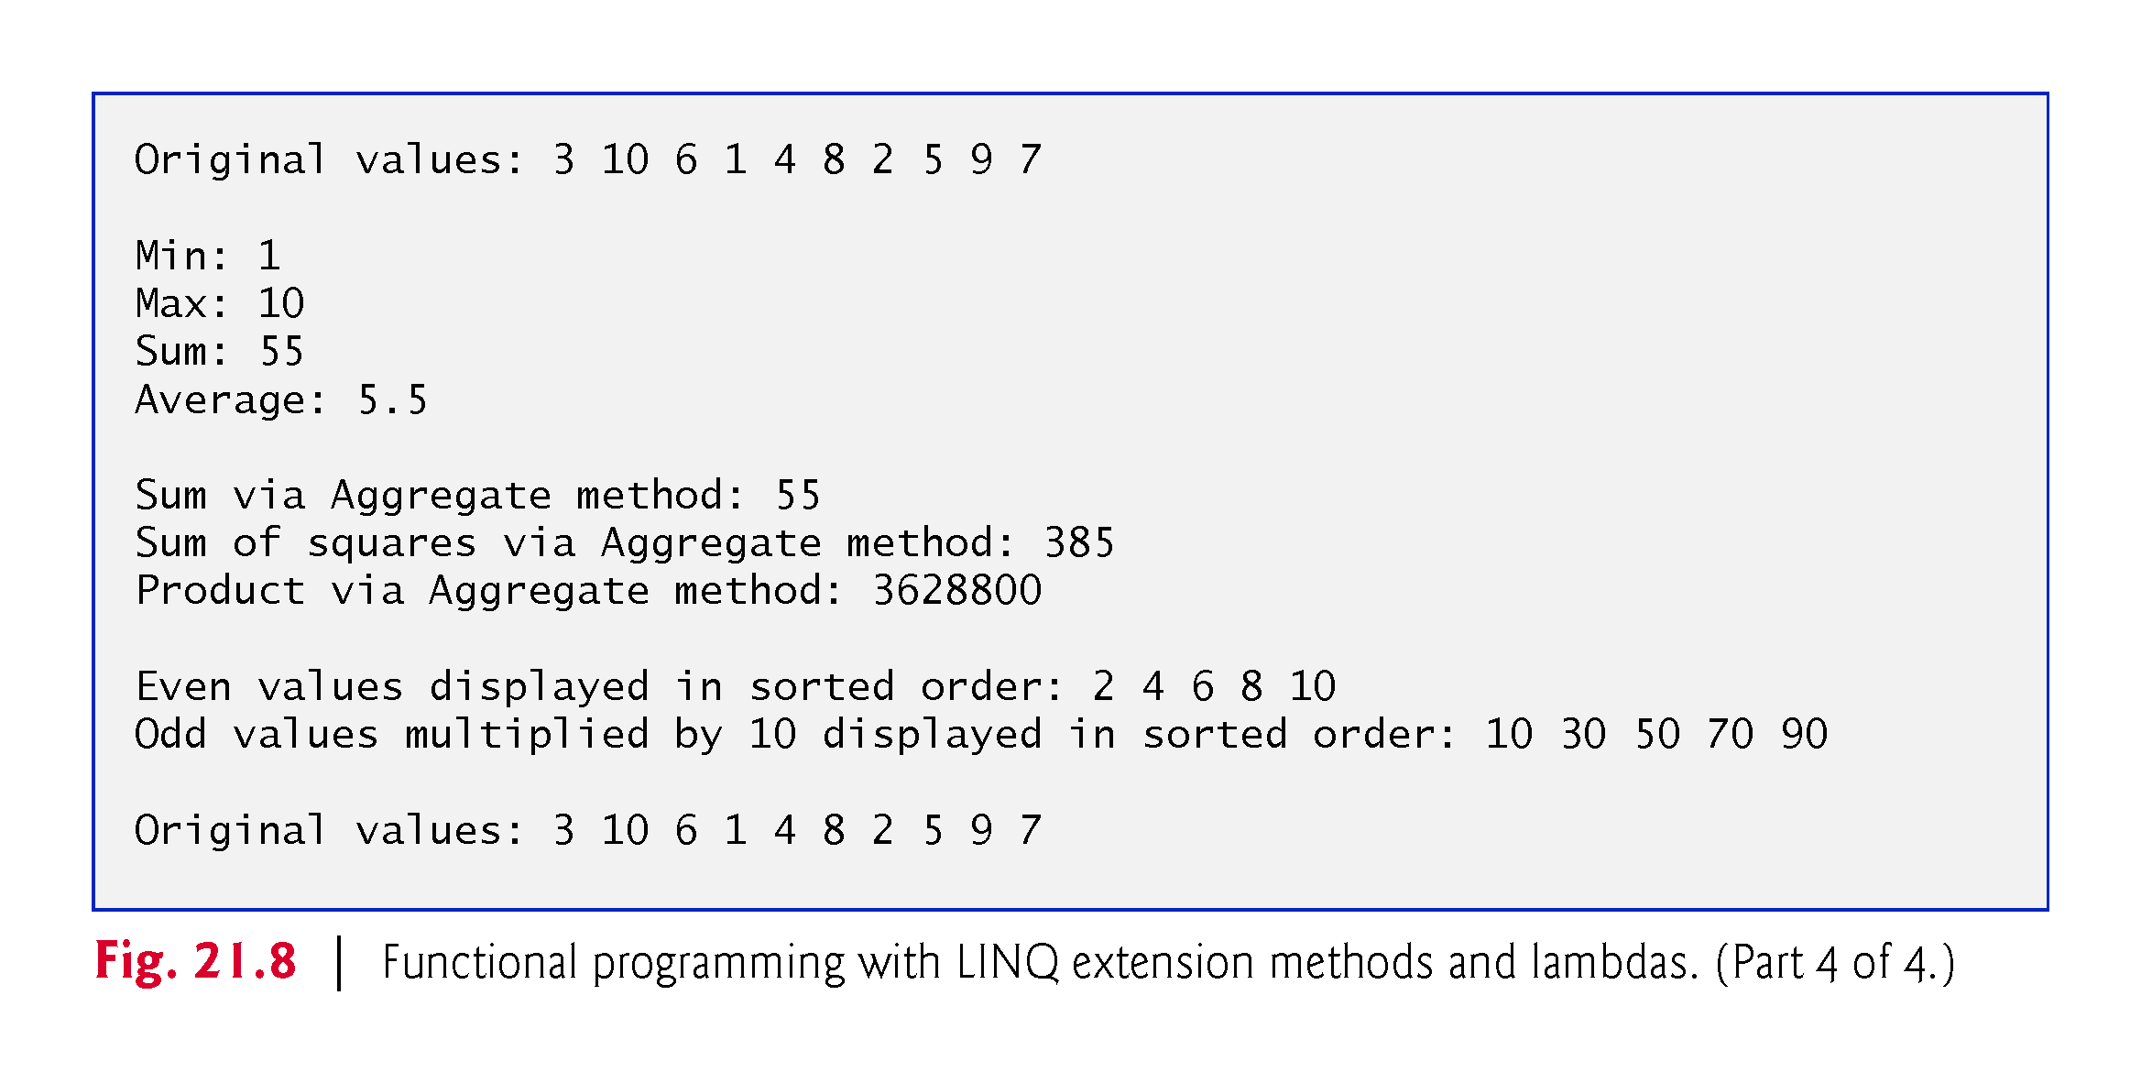

Slide 60
Parallel LINQ (PLINQ)

Slide 61

https://docs.microsoft.com/en-us/dotnet/api/system.linq.enumerable.range?view=net-6.0

Slide 62

Enumerable.Range(Int32, Int32) Method
Generates a sequence of integral numbers within a specified range.
Notes:
https://learn.microsoft.com/en-us/dotnet/api/system.linq.enumerable.range?view=net-7.0

Slide 63

https://docs.microsoft.com/en-us/dotnet/api/system.linq.enumerable.range?view=net-6.0

Slide 64

???
Select int in the range 1-999

Slide 65


Slide 66

!!!
Notes:
https://www.dotnetperls.com/asparallel

Slide 67


Slide 68
AsParallel. Query expressions can be run in parallel. With the AsParallel extension method, we enable parallel threads to improve performance. We show a method that becomes twice as fast on a dual-core machine when AsParallel is used.
https://www.dotnetperls.com/asparallel

Slide 69
Parallel LINQ (PLINQ)
https://docs.microsoft.com/en-us/dotnet/standard/parallel-programming/introduction-to-plinq
Parallel LINQ (PLINQ) is a parallel implementation of the Language-Integrated Query (LINQ) pattern. PLINQ implements the full set of LINQ standard query operators as extension methods for the System.Linq namespace and has additional operators for parallel operations. PLINQ combines the simplicity and readability of LINQ syntax with the power of parallel programming.

Slide 70


Slide 71


Slide 72

Q&A

Slide 73
Q&A
Ch 9.
1. imperative programming & declarative programming
2. Fig. 9.2. Fig.9.4. Fig. 9.7
3. deferred Execution?
Ch 21.
1. motivation to use delegation (function)
2. motivation to use lambda expression while applying delegation function,
3. Aggregation function?
4. motivation of plinq
5. fig.21.6, fig.21.7, fig.21.8, fig.21.9

